Slide 1
Huckleberry Finn Mark Twain

Slide 2
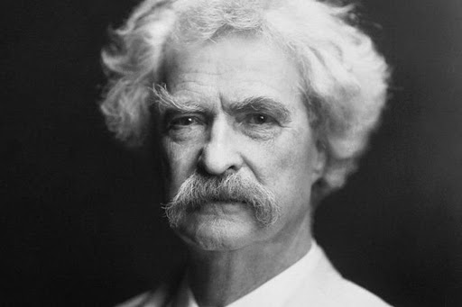
Author
The King's and Queen's Club

Slide 3
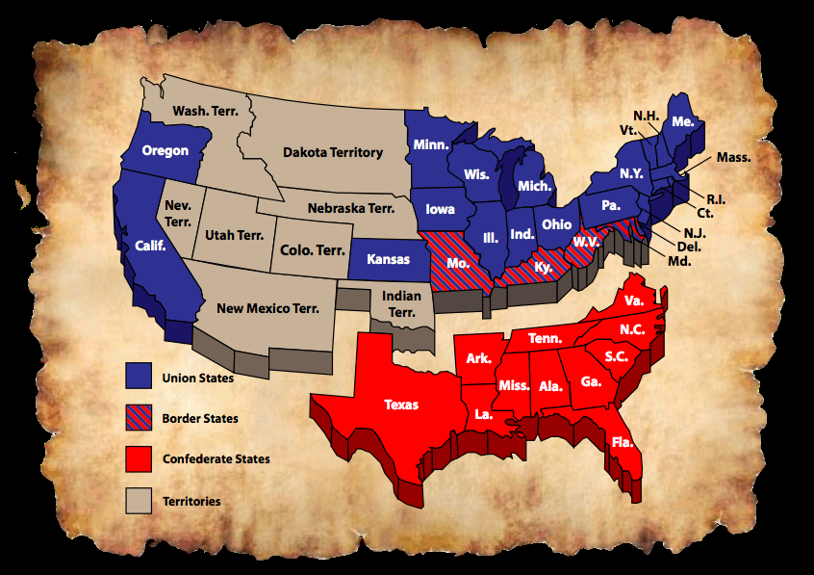
The American Civil War
The King's and Queen's Club

Slide 4
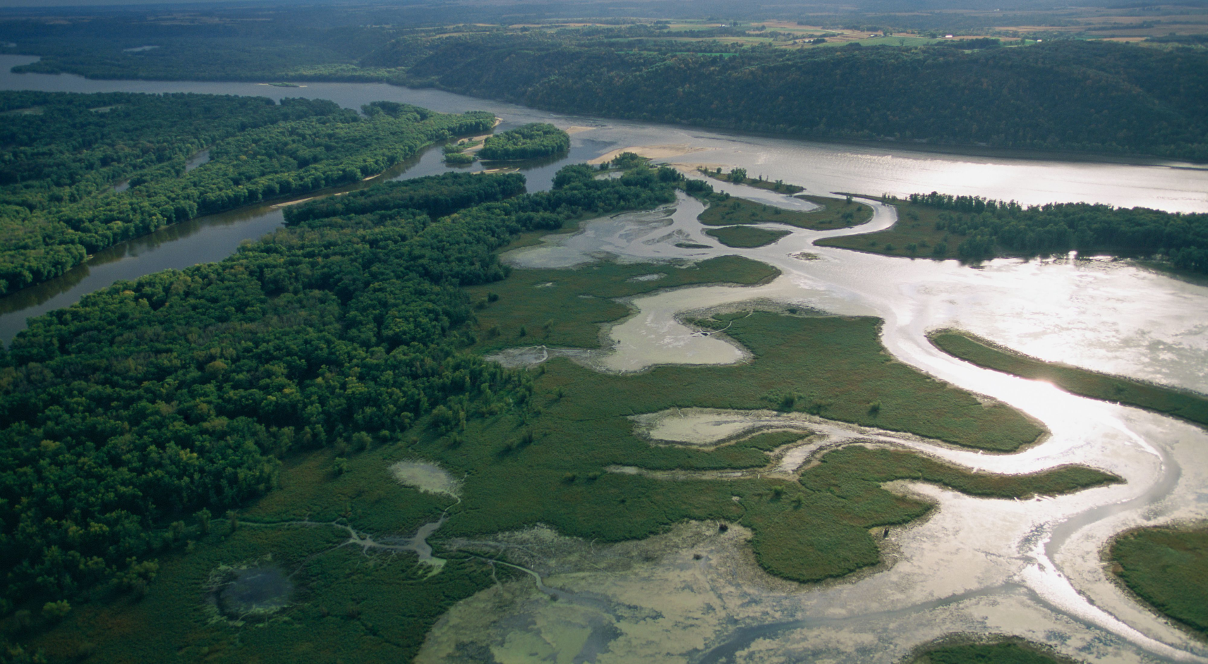
Setting
The King's and Queen's Club

Slide 5
Themes
The King's and Queen's Club

Slide 6
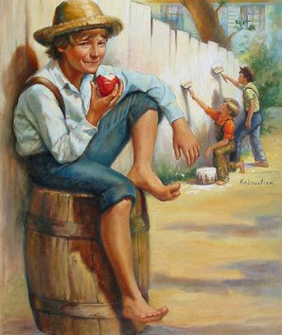
Characters and Character Development
The King's and Queen's Club

Slide 7
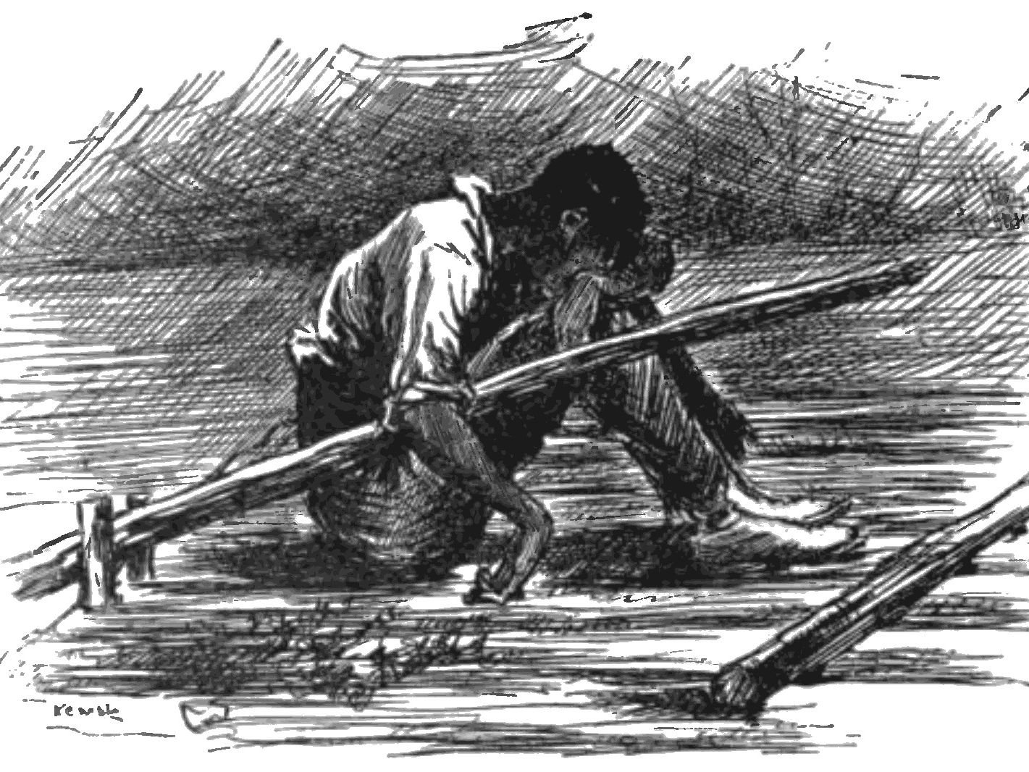
Impact
The King's and Queen's Club

