Slide 1
Macbeth
By William Shakespeare
Grades 10-12

Slide 2
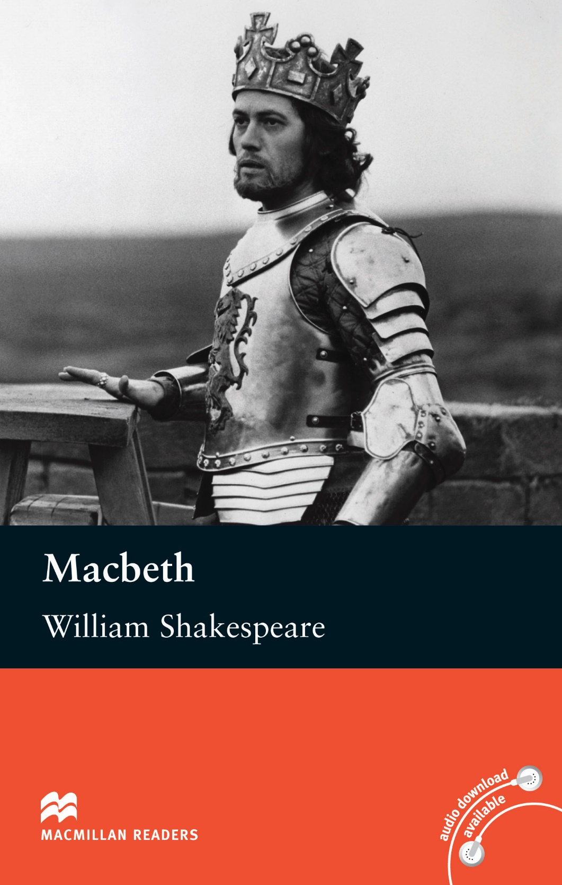
Agenda
Vocabulary - ლექსიკა
Main themes - მთავარი თემები
Conclusion and Homework - შეჯამება და დავალება
About the Author- ავტორის შესახებ
Summary - შინაარსი
Characters - გმირები
Setting - მოქმედების ადგილი და დრო

Slide 3
Vocabulary
to foretell (v.)
prophecy
(n.)
ambition (n.)
To predict the future
A prediction of what will happen in the future
A strong desire and determination to achieve success
temptation
(n.)
supernatural (adj.)
Something that attracts someone to do something wrong
Unnatural, something beyond scientific understanding
guilt (n.)
ruthless (adj.)
enemy (n.)
The feeling of having committed a wrongdoing
Having no pity or compassion for others
A person who is actively opposed to or hostile towards someone

Slide 4
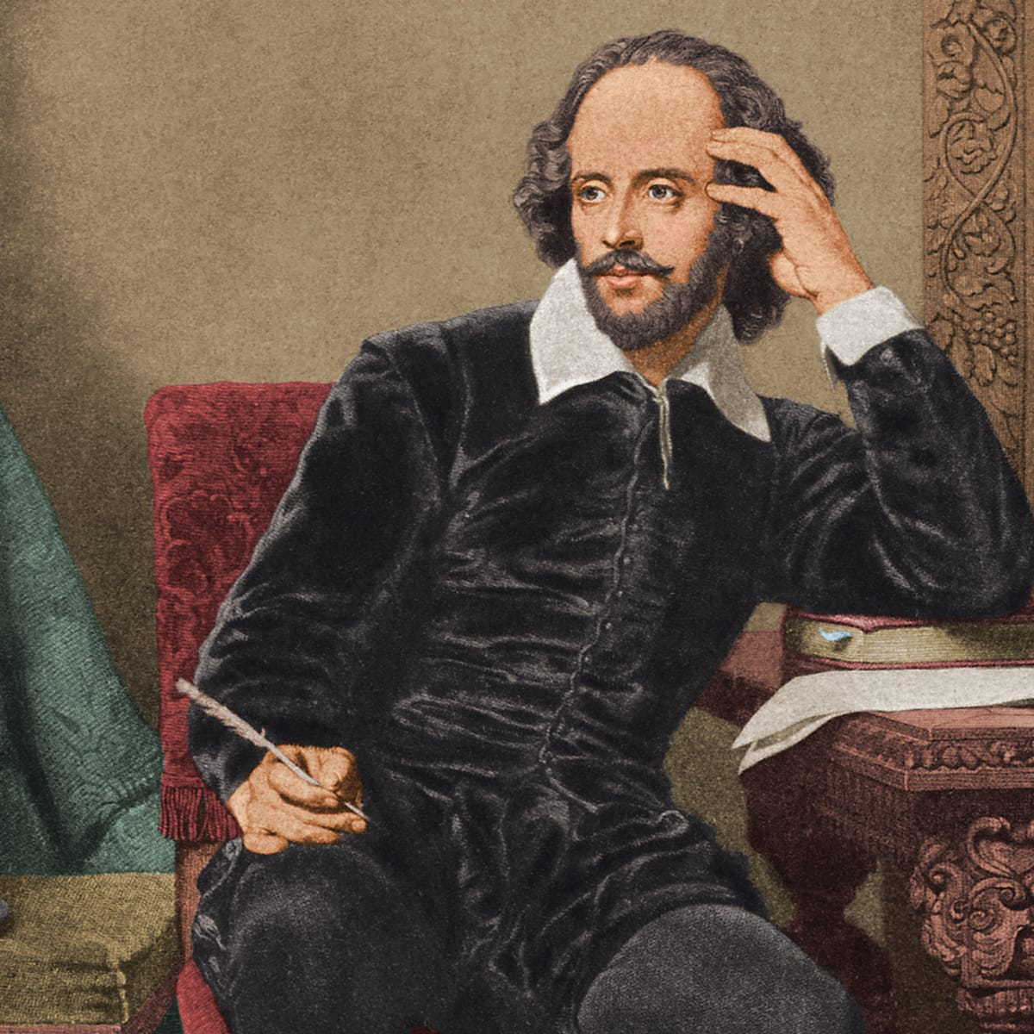
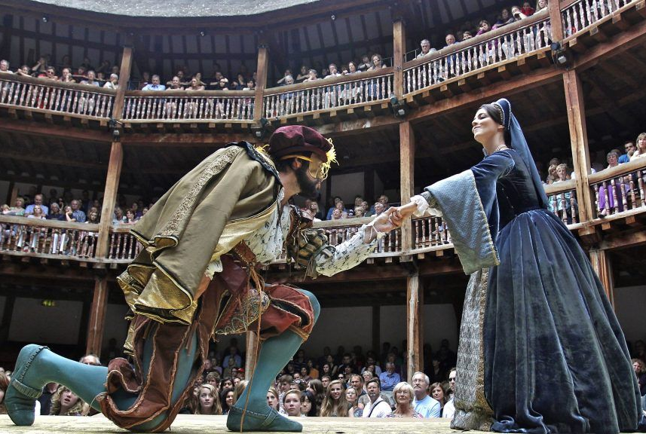
About the Author

Slide 5
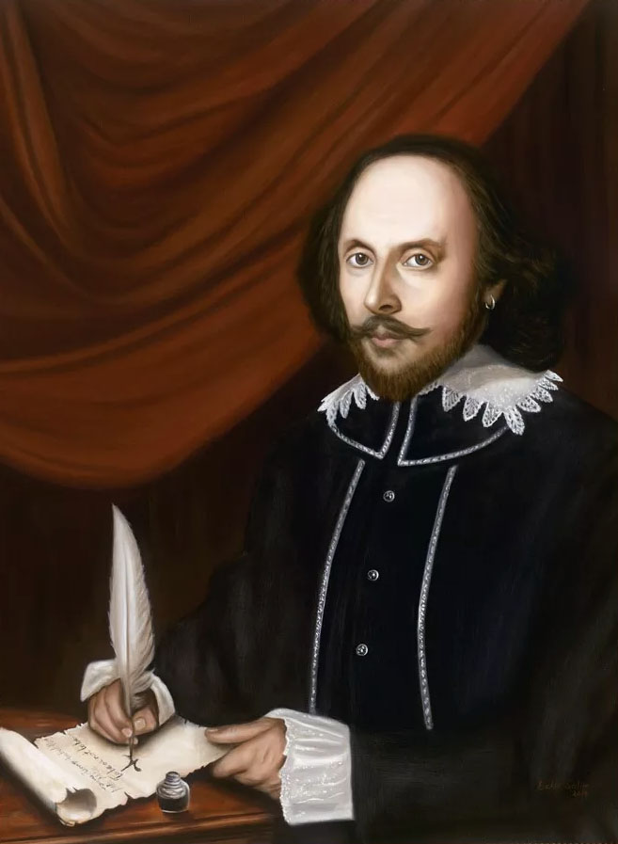
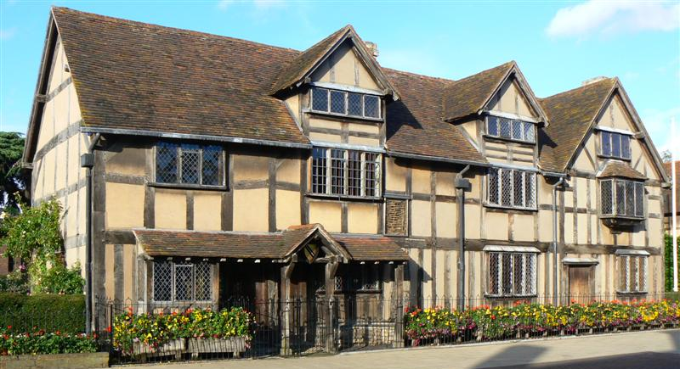
William Shakespeare
1564 – 1616
Stratford-upon-Avon, England

Slide 6
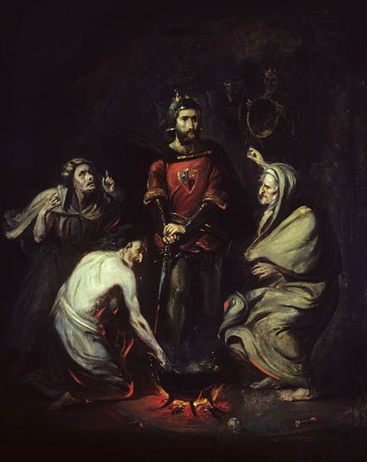
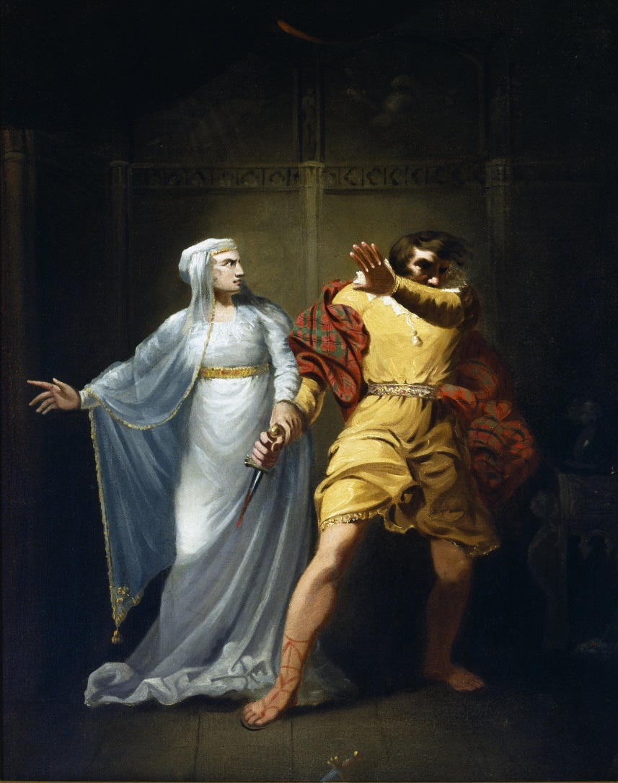
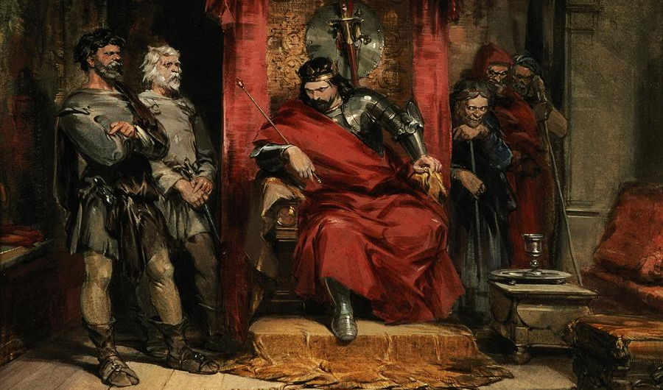
Summary შინაარსი

Slide 7
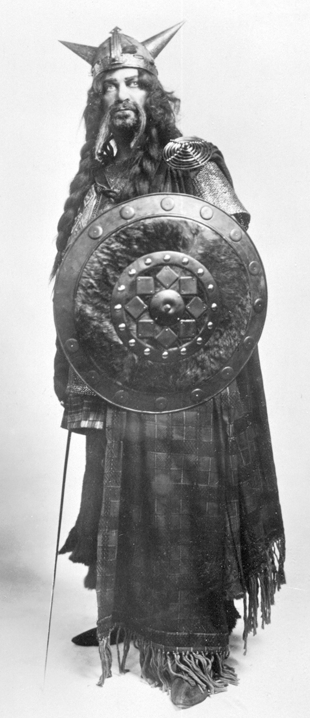
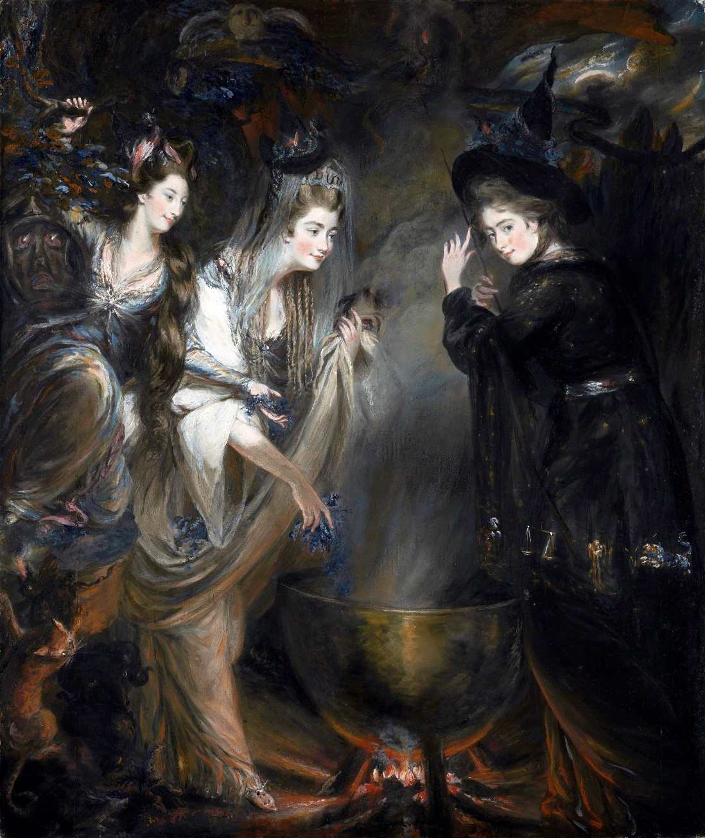
Characters
Lady Macbeth
Three Witches
Macbeth
Macduff

Slide 8
Setting მოქმედების ადგილი და დრო

Slide 9
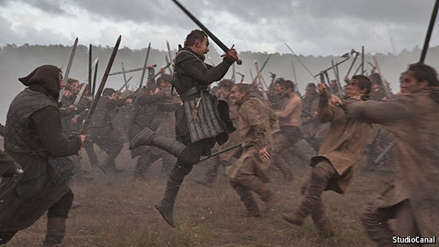
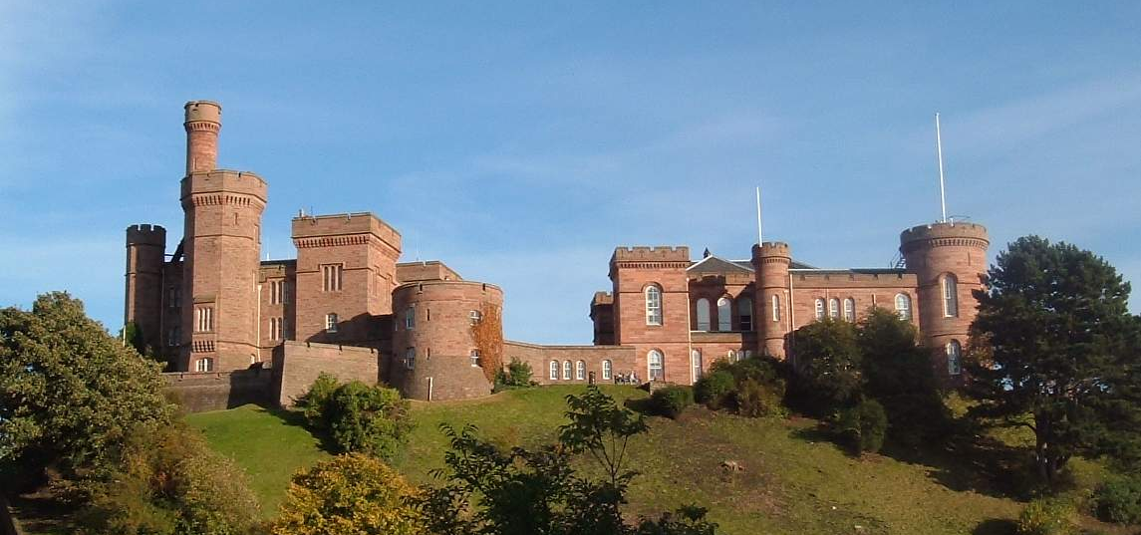
When
11th century
Where
Scotland

Slide 10
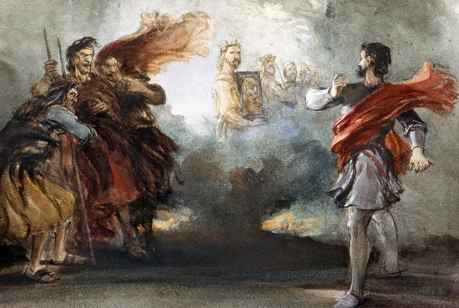
Main Themes მთავარი თემები

Slide 11
Conclusion
Author
Summary
Setting
Themes
Characters
William Shakespeare
Gender & Power; Corrupting Power of Ambition
Consumed by ambition and moved to action by his wife, Macbeth murders King Duncan and takes the Scottish throne for himself.
11th century
Scotland
Macbeth, Lady Macbeth, Macduff, the Three Witches

Slide 12
Vocabulary
to foretell (v.)
prophecy
(n.)
ambition (n.)
To predict the future
A prediction of what will happen in the future
A strong desire and determination to achieve success
temptation
(n.)
supernatural (adj.)
Something that attracts someone to do something wrong
Unnatural, something beyond scientific understanding
guilt (n.)
ruthless (adj.)
enemy (n.)
The feeling of having committed a wrongdoing
Having no pity or compassion for others
A person who is actively opposed to or hostile towards someone

Slide 13
Homework
Do you think the three witches created Macbeth’s desire to become king, or do you think he always (secretly) had that ambition? Explain your answer.
დავალება შეგიძლიათ
ატვირთოთ შემდეგ
მისამართზე:
www.englishbookeducation.co.uk/homework

