Slide 1

Emma
By Jane Austen
Grades 10-12

Slide 2


Agenda
Vocabulary - ლექსიკა
Main themes - მთავარი თემები
Conclusion and Homework - შეჯამება და დავალება
About the Author- ავტორის შესახებ
Summary - შინაარსი
Characters - გმირები
Setting - მოქმედების ადგილი და დრო

Slide 3
Vocabulary
to introduce
(v.)
to meddle
(v.)
matchmaking
(n.)
The arranging of marriages between other people
To bring people together so they meet for the first time
To interfere in something that is none of your business
considerate
(adj.)
to misunderstand (v.)
Careful not to inconvenience or harm others
To incorrectly understand the meaning of something
insightful (adj.)
foolish (adj.)
mistake (n.)
Having a true and deep understanding
Not having good sense or judgment
An act or judgment that is incorrect or wrong

Slide 4
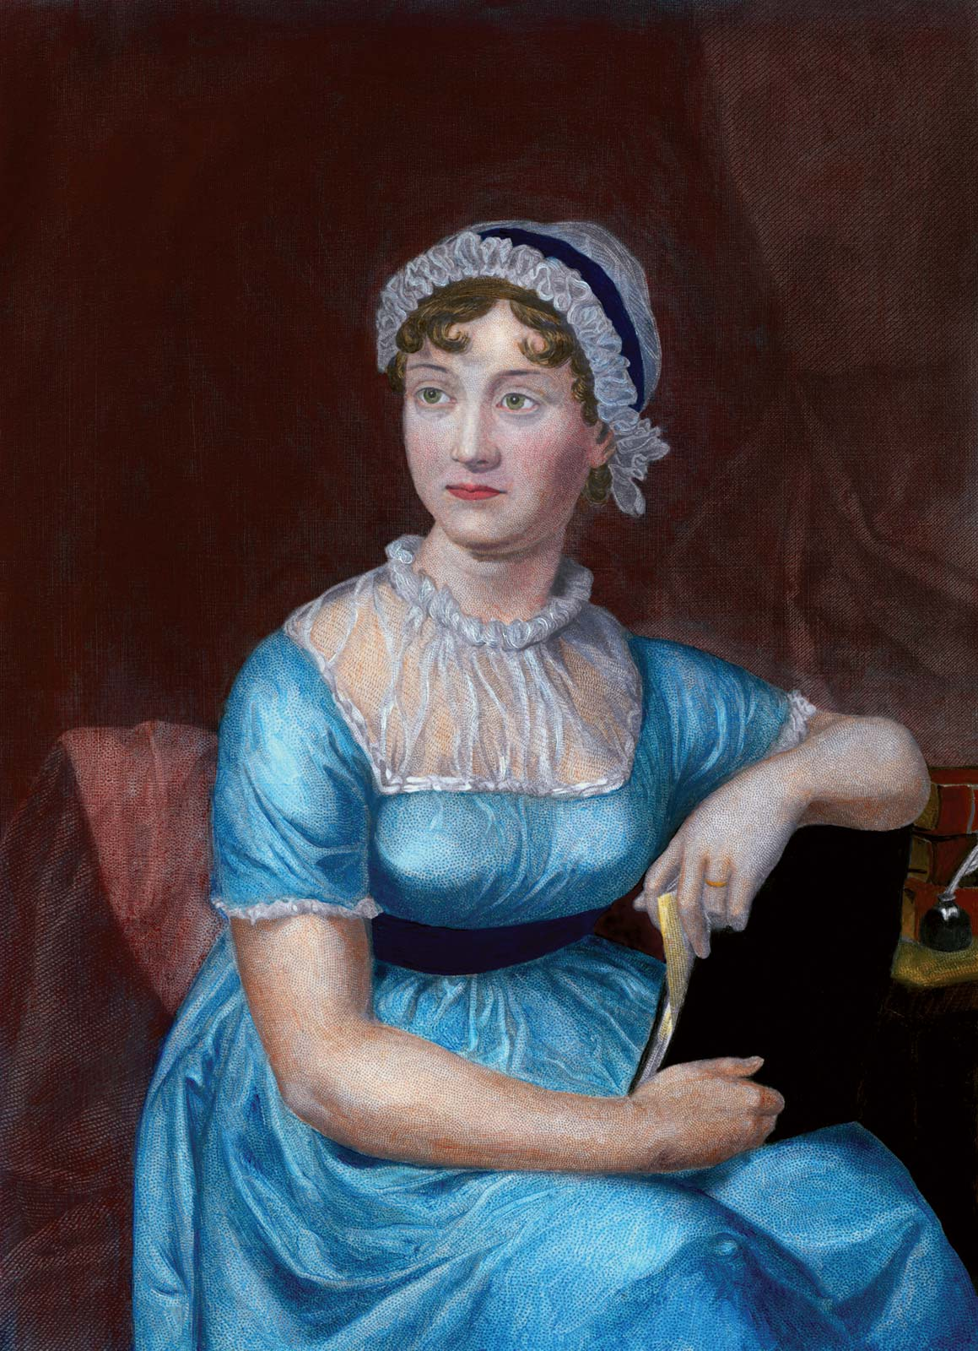
About the Author

Slide 5
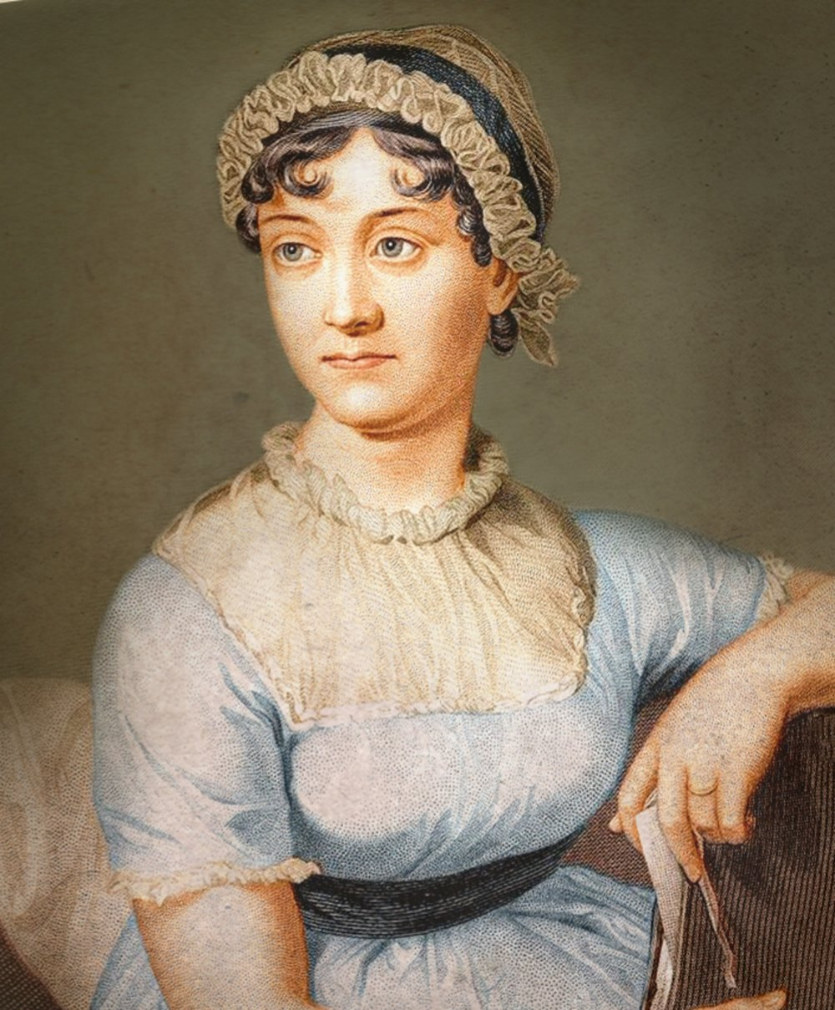
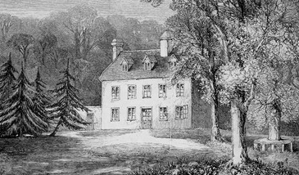
Jane Austen
1775 – 1817
Steventon, England

Slide 6
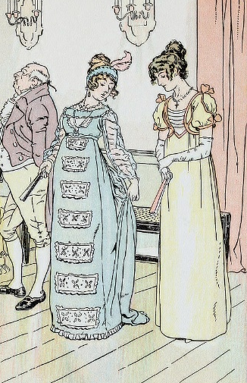
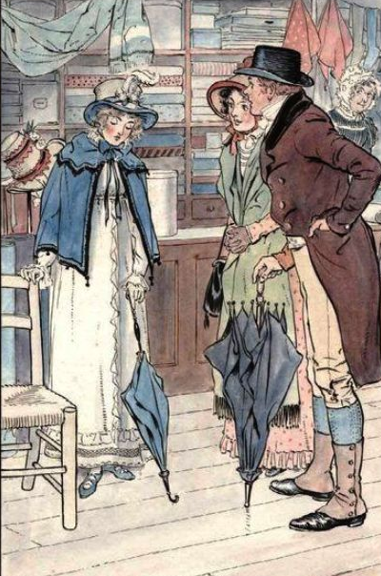
Summary შინაარსი

Slide 7
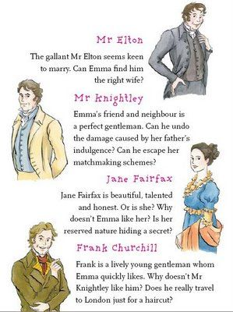
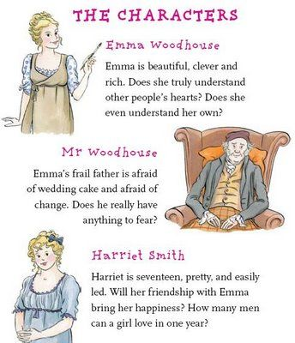
Characters
Emma
Woodhouse
Mr. Knightley
Harriet Smith
Mr. Elton
Mr. Woodhouse

Slide 8
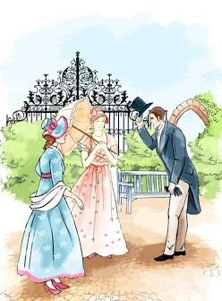
Setting მოქმედების ადგილი და დრო

Slide 9
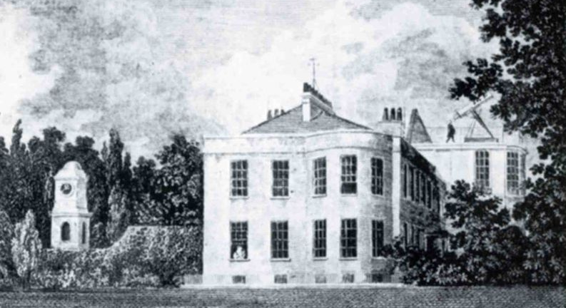
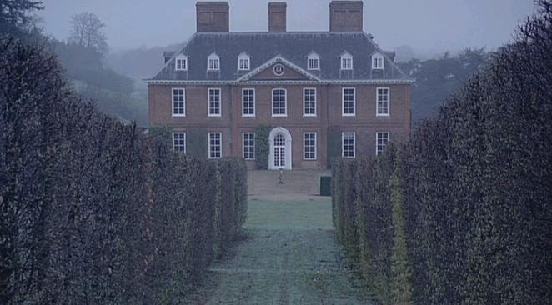
When
Early 19th century
Where
Highbury, England

Slide 10
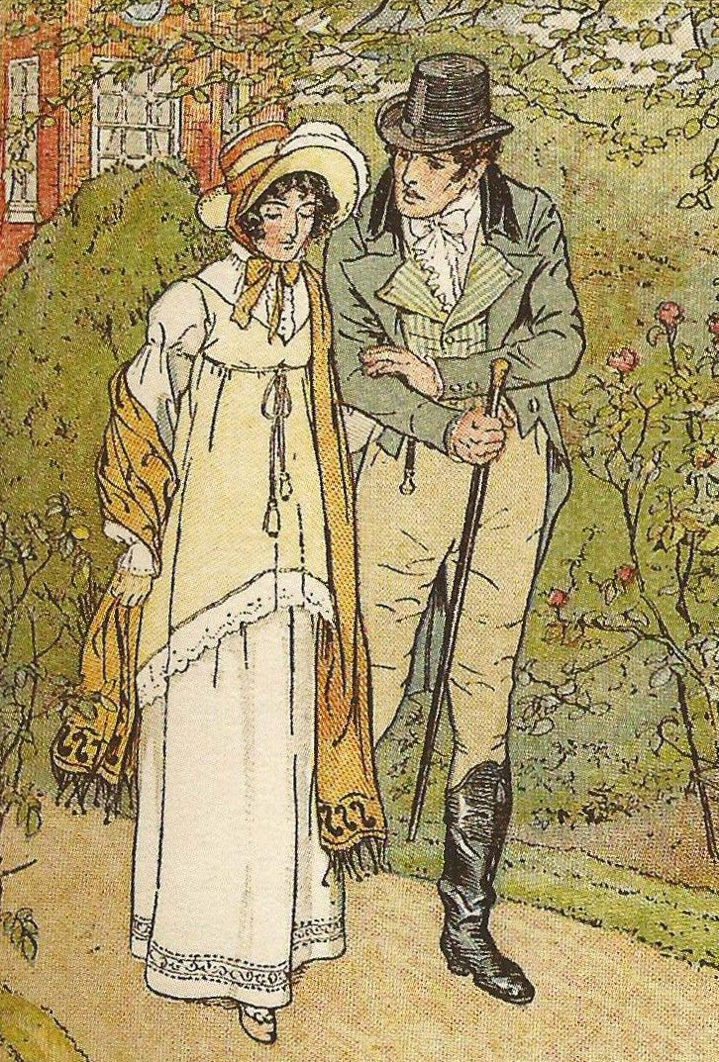
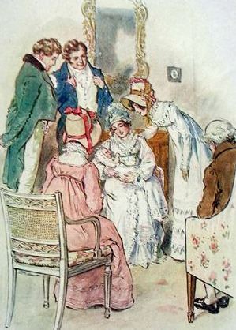
Main Themes მთავარი თემები

Slide 11
Conclusion
Author
Summary
Setting
Themes
Characters
Jane Austen
Marriage and Social Status; Parenting
The story about a young woman whose misplaced confidence in her matchmaking abilities creates several romantic misadventures.
Early 19th century
Highbury, England
Emma, Mr. Knightley, Harriet Smith, Mr. Elton, Mr. Woodhouse

Slide 12
Vocabulary
to introduce
(v.)
to meddle
(v.)
matchmaking
(n.)
The arranging of marriages between other people
To bring people together so they meet for the first time
To interfere in something that is none of your business
considerate
(adj.)
to misunderstand (v.)
Careful not to inconvenience or harm others
To incorrectly understand the meaning of something
insightful (adj.)
foolish (adj.)
mistake (n.)
Having a true and deep understanding
Not having good sense or judgment
An act or judgment that is incorrect or wrong

Slide 13
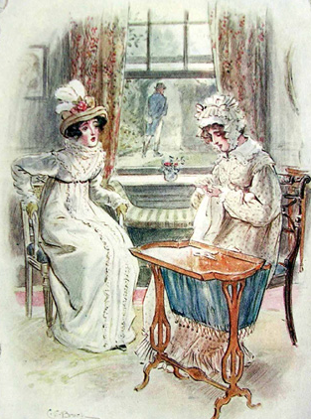
Homework
Describe a time when you completely misunderstood a social situation. What were the consequences of your mistake? What did you learn from this experience?
დავალება შეგიძლიათ
ატვირთოთ შემდეგ
მისამართზე:
www.englishbookeducation.co.uk/homework

