Slide 1
Sign of Four
Sir Arthur Conan Doyle

Slide 2
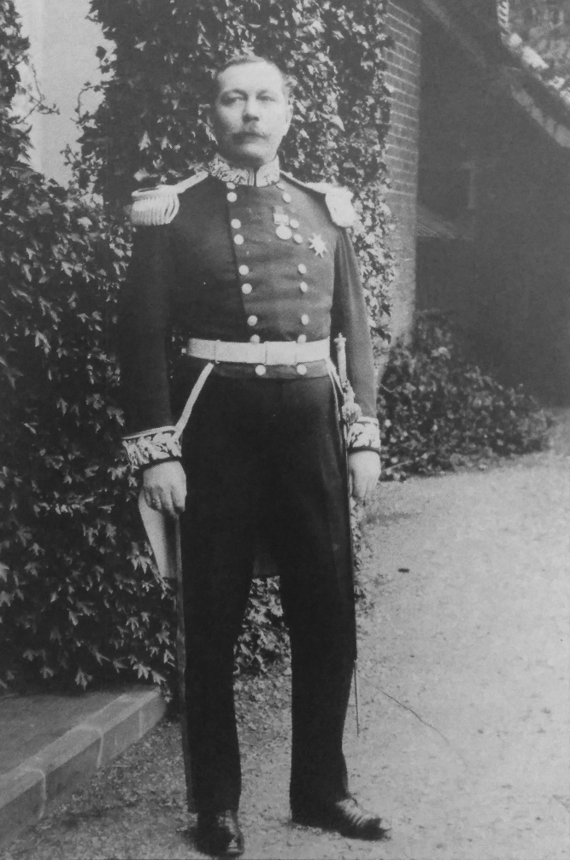
Sir Arthur Conan Doyle

Slide 3
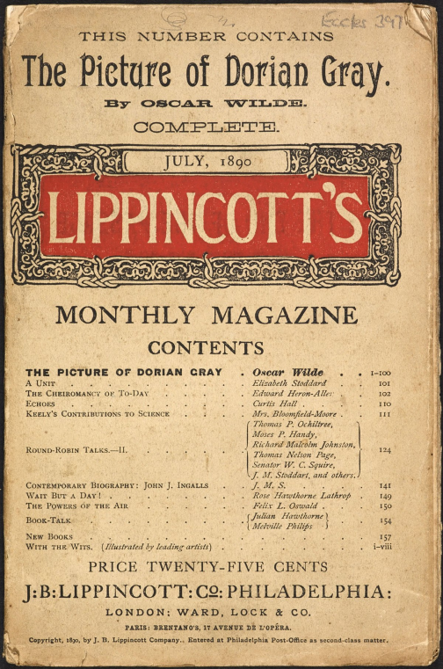
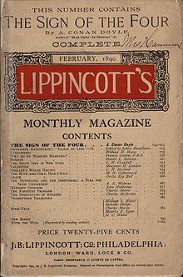
How it all began
30 August 1889

Slide 4
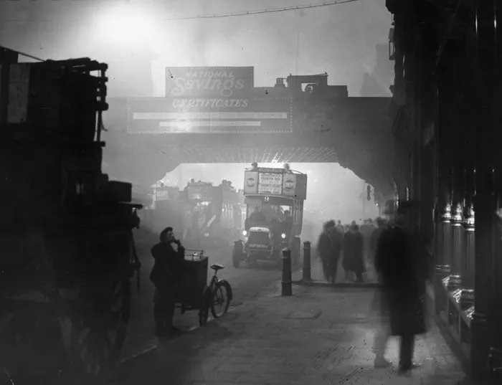
Setting

Slide 5
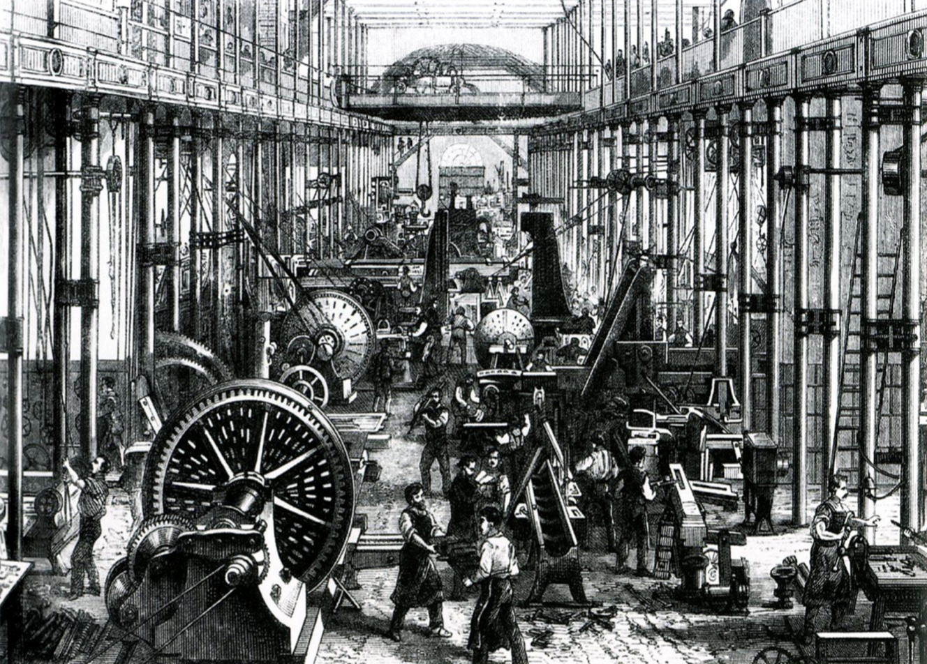
THEMES

Slide 6
Sherlock Holmes

Slide 7
Doctor John Watson

Slide 8
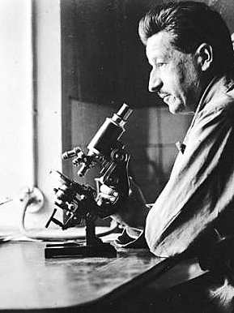
Impact

Slide 9
Impact
The King's and Queen's Club

