Slide 2
Schools around the World
სკოლები მსოფლიოს გარშემო
ზოგადი ინგლისური დონე: B1

Slide 3
Agenda
გაკვეთილის განრიგი
Vocabulary - ლექსიკა
Reading Comprehension - წაკითხულის გააზრება
Grammar - გრამატიკა
Summary - შეჯამება
Homework - დავალება

Slide 4
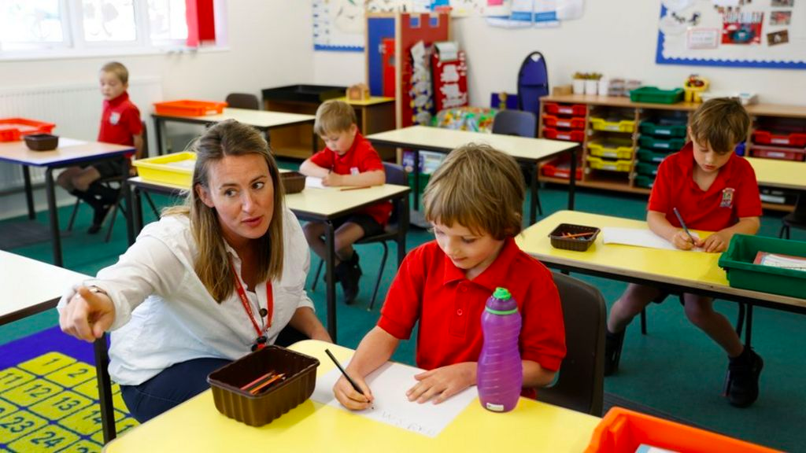
Introduction
შესავალი
What was your school life like?

Slide 5
skip
(n./v.)
term
(n.)
graduation
(n.)
გაცდენა
სასწავლო დაწესებულების დამთავრება
სემესტრი
Vocabulary ლექსიკა
compulsory
(adj.)
scholarship
(n.)
სავალდებულო
სტიპენდია
drop
(n. / v.)
curriculum
(n.)
ამორიცხვა
სასწავლო გეგმა, პროგრამა

Slide 6
Vocabulary
ლექსიკა
skip
(n./v.)
გაცდენა

Slide 7
Vocabulary
ლექსიკა
graduation
(n.)
სასწავლო დაწესებულების დამთავრება

Slide 8
Vocabulary
ლექსიკა
scholarship
(n.)
სტიპენდია

Slide 9
Vocabulary
ლექსიკა
curriculum
(n.)
სასწავლო გეგმა, პროგრამა

Slide 10
Vocabulary
ლექსიკა
drop
(n./v.)
ამორიცხვა

Slide 11
Vocabulary
ლექსიკა
compulsory
(adj.)
სავალდებულო

Slide 12
Vocabulary
ლექსიკა
term
(n.)
სემესტრი

Slide 13
Vocabulary
ლექსიკა
term
compulsory
drop
curriculum
scholarship
graduation
skip
to decide not to continue studying a school subject

Slide 14
Vocabulary
ლექსიკა
term
compulsory
curriculum
scholarship
graduation
skip
the subjects that students study at a particular school or college

Slide 15
Vocabulary
ლექსიკა
term
compulsory
scholarship
graduation
skip
an amount of money given by a school, college, university, or other organisation to pay for the studies of a person

Slide 16
Vocabulary
ლექსიკა
term
compulsory
graduation
skip
not to do something, but to do the next thing instead; to miss a lesson

Slide 17
Vocabulary
ლექსიკა
term
compulsory
graduation
one of the periods of time into which the year is divided for students

Slide 18
Vocabulary
ლექსიკა
compulsory
graduation
something that must be done because of a rule or law

Slide 19
Vocabulary
ლექსიკა
graduation
the act of receiving a degree or other qualification after finishing your studies at a college or university

Slide 20
pupil
(n.)
background
(n.)
მოსწავლე
principal
(n.)
ბიოგრაფიული ინფორმაცია
სკოლის დირექტორი
Vocabulary ლექსიკა
to improve
(v.)
playground
(n.)
გაუმჯობესება
სათამაშო მოედანი
to immerse
(v.)
after-school (activities)
(adj.)
მთლიანად დაუფლება
სკოლის შემდეგი
(აქტივობები)

Slide 21
Vocabulary
ლექსიკა
pupil
(n.)
მოსწავლე

Slide 22
Vocabulary
ლექსიკა
principal
(n.)
სკოლის დირექტორი

Slide 23
Vocabulary
ლექსიკა
to improve
(v.)
გაუმჯობესება

Slide 24
Vocabulary
ლექსიკა
after-school
(activities)
(adj.)
სკოლის შემდეგი (აქტივობები)

Slide 25
Vocabulary
ლექსიკა
to immerse
(v.)
მთლიანად დაუფლება

Slide 26
Vocabulary
ლექსიკა
playground
(n.)
სათამაშო მოედანი

Slide 27
Vocabulary
ლექსიკა
background
(n.)
ბიოგრაფიული ინფორმაცია

Slide 28
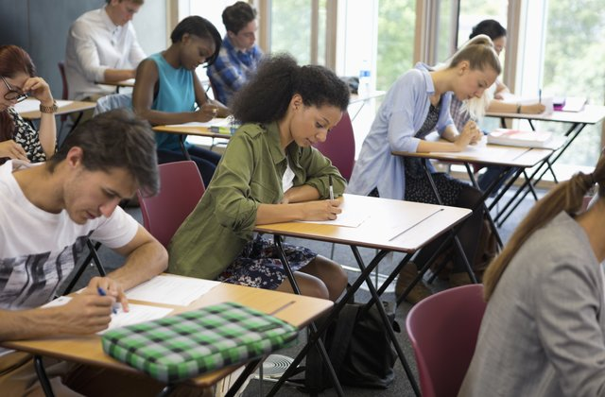
Reading Comprehension
წაკითხულის გააზრება
What is the school system like in your country?

Slide 29
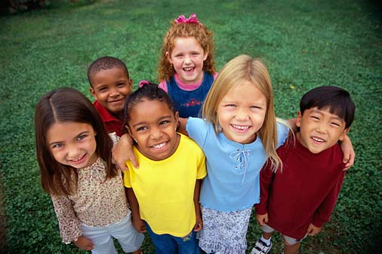
Reading Comprehension
წაკითხულის გააზრება
The kids in a school in South London come from 60 countries. At home they speak a total of 71 languages, but at school their lessons are all in English.
Imagine taking all your school exams in English, even in Maths and History! What if you had to talk to your teachers in English every day? In London, lots of teens do this – although English isn’t their first language. Their families have moved to Britain from other countries, but these kids can’t miss school.
At Southfields Community College, in Wandsworth, South London, the 1,300 pupils come from all over the world – from around 60 countries altogether. “I have friends from Pakistan, Ghana, Nigeria and Britain.” Between them, Southfields pupils speak 71 languages – more than at any other school in Britain!
Don’t all those different languages make school very chaotic? Shahid Syed, 16, from Pakistan, speaks Urdu, Punjabi and a little Pashto. But he tries to make things easy at school. “We all speak English in the classroom,” Shahid says. “But at home I speak Urdu as much as possible because we try to keep our culture.”

Slide 30
Reading Comprehension
წაკითხულის გააზრება
London has many multicultural schools, but Southfields can be especially proud. In 2006 it was one of the top 100 most improved schools in the country. This is great because many of the pupils spoke little or no English when they first arrived. “We believe the best way for pupils to improve their English is by listening and speaking in class,” said Anita Sollis, a teacher at Southfields. “Most teens have some basic English when they arrive, and we immerse them in English in class. It’s fantastic how quickly they learn from being surrounded by the language.” If kids speak no English at all, Southfields takes these pupils out of class for one period a day to give them English lessons.
Sports and activities are also important. Ifrah Omar, 15, from Somalia, speaks Somali and Arabic. She said after-school clubs helped her to make friends and settle down in Britain. “When I got here, I met friends playing sport. I didn’t know how to play the games, I couldn’t speak English and I didn’t know anyone – but the others helped me. I still have these friends today.” Southfields offers a lot of after-school sports and activities. “Clubs and sports are a great way for people to mix,“ said Anita Sollis. “It’s interesting for the British pupils too because they meet other teens from all over the world.”

Slide 31
Reading Comprehension
წაკითხულის გააზრება
A lot of kids at Southfields know that education is very important. Some are extremely motivated after bad experiences they had before moving to Britain. Fadumo Yusuf, 15, from Somalia, told the British newspaper “The Guardian” that the kids were treated very strictly by the teachers and the principal in her home country. “When I came here, I didn’t know any English,” said Fadumo. “Now I’m preparing for my exams.”
But Southfields offers much more than exams. It’s a chance to learn about other cultures. Kristina Dumova, 13, from Bulgaria, has been there for just a few months. But she’s already learned a lot about other cultures. “My friends come from Brazil, so I’m learning about their country and language. I also teach my friends about Bulgarian traditions.” Walking around the playground is like a trip around the world. Kids from Italy, South Africa, India, Iraq, China, Somalia, Thailand, Bangladesh and many other countries play together. Shahid knows a lot of the kids and he’s proud of his knowledge of other cultures. He said, “It makes you feel clever to know people from so many different backgrounds.”

Slide 32
Reading Comprehension
წაკითხულის გააზრება
Answer the given questions:
უპასუხეთ მოცემულ შეკითხვებს:
1. What makes Southfields proud and exceptional?
In 2006 it was one of the top 100 most improved schools in the country. This is great because many of the pupils spoke little or no English when they first arrived.

Slide 33
Reading Comprehension
წაკითხულის გააზრება
Answer the given questions:
უპასუხეთ მოცემულ შეკითხვებს:
2. Why is it important for the kids to speak their mother tongue at home?
Not to forget their cultural background.

Slide 34
Reading Comprehension
წაკითხულის გააზრება
Answer the given questions:
უპასუხეთ მოცემულ შეკითხვებს:
3. How do after-school activities help the kids?
They make friends from all over the world.

Slide 35
Reading Comprehension
წაკითხულის გააზრება
Answer the given questions:
უპასუხეთ მოცემულ შეკითხვებს:
4. What happens if the kids can not speak English when they arrive at school?
They get one extra lesson of English a day instead of another subject.

Slide 36
Grammar
გრამატიკა
Indefinite Pronouns
განუსაზღვრელი ნაცვალსახელები
Some, any and no are used with uncountable nouns (coffee, sugar, etc.) and plural countable nouns (cars, flowers, etc.)
some coffee;
some cars.

Slide 37
Grammar
გრამატიკა
Indefinite Pronouns
განუსაზღვრელი ნაცვალსახელები
Some and its compounds (someone/somebody, something, somewhere) are normally used in affirmative sentences.
He has got some friends.

Slide 38
Grammar
გრამატიკა
Indefinite Pronouns
განუსაზღვრელი ნაცვალსახელები
Any and its compounds are usually used in interrogative sentences. Not any is used in negative sentences.
Have you got any money?
I don’t have any money.

Slide 39
Grammar
გრამატიკა
Indefinite Pronouns
განუსაზღვრელი ნაცვალსახელები
Any and its compounds are also used with negative words such as without, never, seldom, rarely, hardly, etc.
He left without any excuse.

Slide 40
Grammar
გრამატიკა
Indefinite Pronouns
განუსაზღვრელი ნაცვალსახელები
No and its compounds are used instead of not any in negative sentences.
They have no time.

Slide 41
Grammar
გრამატიკა
Indefinite Pronouns
განუსაზღვრელი ნაცვალსახელები
We use a singular verb with compounds of some, any and no.
Someone is calling for help.

Slide 42
Grammar
გრამატიკა
Indefinite Pronouns
განუსაზღვრელი ნაცვალსახელები
Some and its compounds are also used in interrogative sentences when we make an offer or a request.
Would you like some apple juice?
Can I say something?

Slide 43
Grammar
გრამატიკა
Indefinite Pronouns
განუსაზღვრელი ნაცვალსახელები
When any and its compounds are used in affirmative sentences, there is a difference in meaning.
You can take any sweets you like (it does not matter which)
Anyone/anybody can enter this competition (It doesn’t matter who)
We can go anywhere you like (It doesn’t matter where).

Slide 44
Grammar
გრამატიკა
Indefinite Pronouns
განუსაზღვრელი ნაცვალსახელები
Every is used with singular countable nouns.
Every citizen must pay taxes.

Slide 45
Grammar
გრამატიკა
Indefinite Pronouns
განუსაზღვრელი ნაცვალსახელები
The pronouns everyone/everybody, everything and the adverb everywhere are used in affirmative, interrogative and negative sentences and are followed by a singular verb.
Everybody wants to be happy.

Slide 46
Grammar
გრამატიკა
Put the correct indefinite pronouns.
ჩასვით სწორი განუსაზღვრელი ნაცვალსახელი.
1. She wants to live ______ by the sea.
She wants to live somewhere by the sea.

Slide 47
Grammar
გრამატიკა
Put the correct indefinite pronouns.
ჩასვით სწორი განუსაზღვრელი ნაცვალსახელი.
2. Does ______ have a phone charger?
Does anybody have a phone charger?

Slide 48
Grammar
გრამატიკა
Put the correct indefinite pronouns.
ჩასვით სწორი განუსაზღვრელი ნაცვალსახელი.
3. She did not bring ______ to the party.
She did not bring anything to the party.

Slide 49
Grammar
გრამატიკა
Put the correct indefinite pronouns.
ჩასვით სწორი განუსაზღვრელი ნაცვალსახელი.
4. She loves ______. She is a very kind person.
She loves everybody. She is a very kind person.

Slide 50
Grammar
გრამატიკა
Put the correct indefinite pronouns.
ჩასვით სწორი განუსაზღვრელი ნაცვალსახელი.
5. I wish _______ would clean this mess up.
I wish somebody would clean this mess up.

Slide 51
Summary
გაკვეთილის შეჯამება
Vocabulary
Schools around the World
სკოლები მსოფლიოს გარშემო
Reading
Grammar: Indefinite Pronouns

Slide 52
Homework
საშინაო დავალება
Write a short paragraph about your school.
დაწერეთ მოკლე აბზაცი თქვენი სკოლის შესახებ.

Slide 53
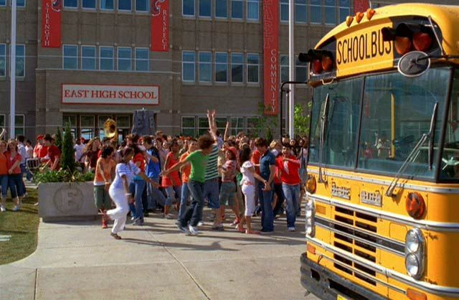
Homework
საშინაო დავალება
School in the US is a bit different that school here in Georgia. I went to three different schools growing: elementary school, middle school and high school. My high school had so many people in it. Around 2000! Each of my schools has lots of after school activities. School in the US usually has three terms and going to class is compulsory. There was a big playground next to my school so we could go play during recess.
School is a great place to immerse yourself and improve your academic skills. I hope love school as much as I did!

