Slide 1

Oliver Twist
By Charles Dickens
Grades 10-12

Slide 2


Agenda
Vocabulary - ლექსიკა
Main themes - მთავარი თემები
Conclusion and Homework - შეჯამება და დავალება
About the Author- ავტორის შესახებ
Summary - შინაარსი
Characters - გმირები
Setting - მოქმედების ადგილი და დრო

Slide 3
Vocabulary
orphan (n.)
workhouse (n.)
poverty (n.)
A place where very poor people could live and work
a child whose parents are dead
The state of being extremely poor
charity (n.)
injustice (n.)
The voluntary giving of help; kindness and tolerance
A lack of fairness or justice
pickpocket
(n.)
cruel (adj.)
to kidnap (v.)
To take someone against their will and hold them captive
A person who steals from people’s pockets; a small-time thief
Intentionally causing pain or suffering

Slide 4
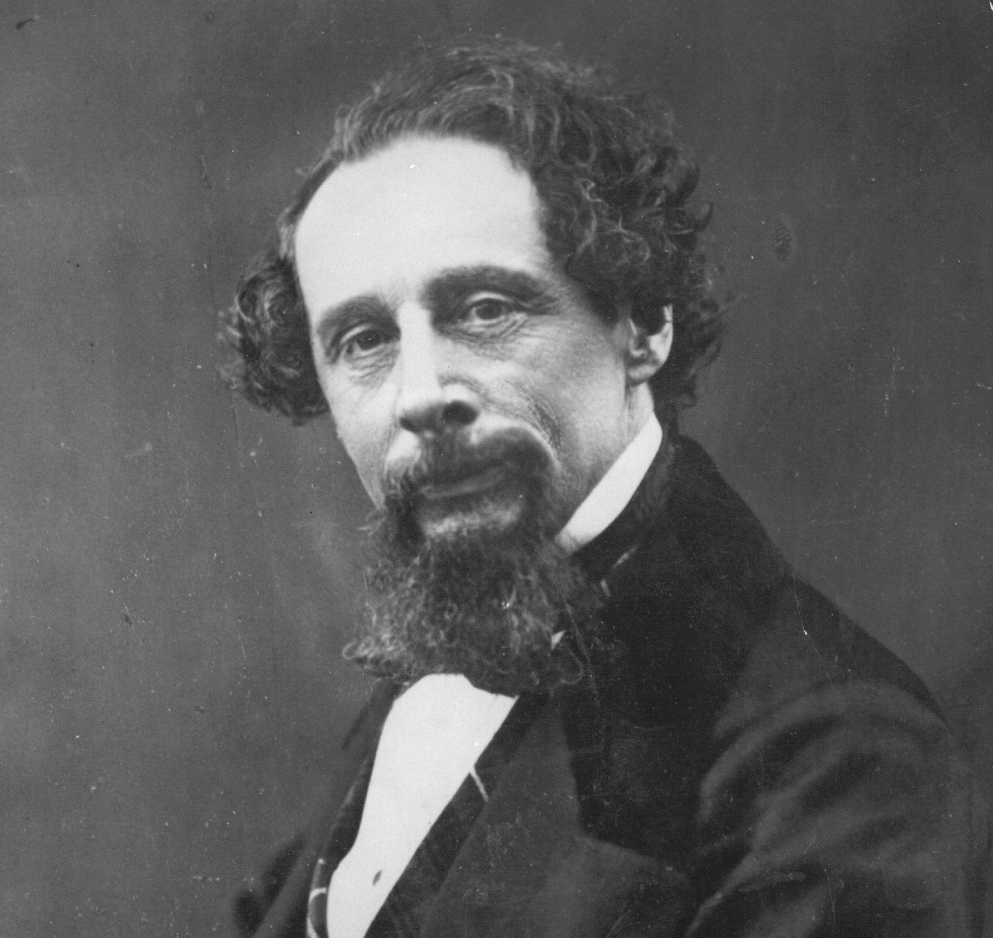
About the Author

Slide 5
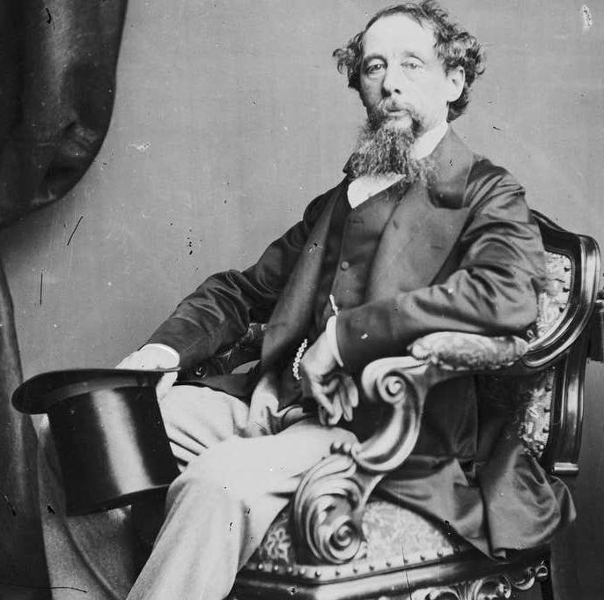
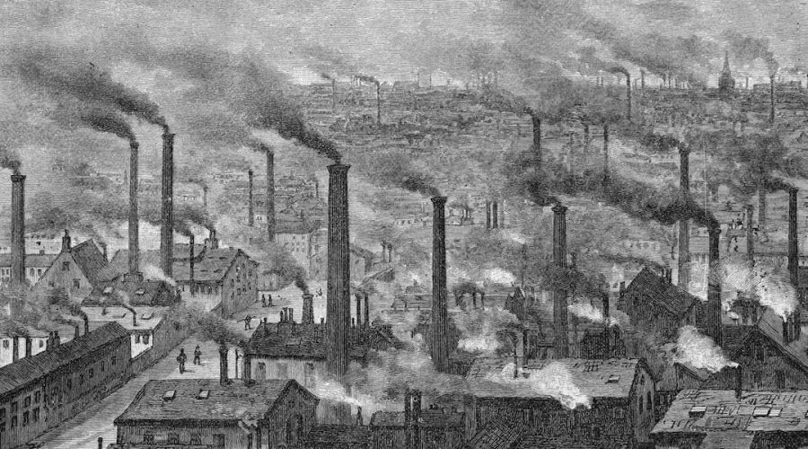
Charles Dickens
1812 – 1870
Portsmouth, England

Slide 6
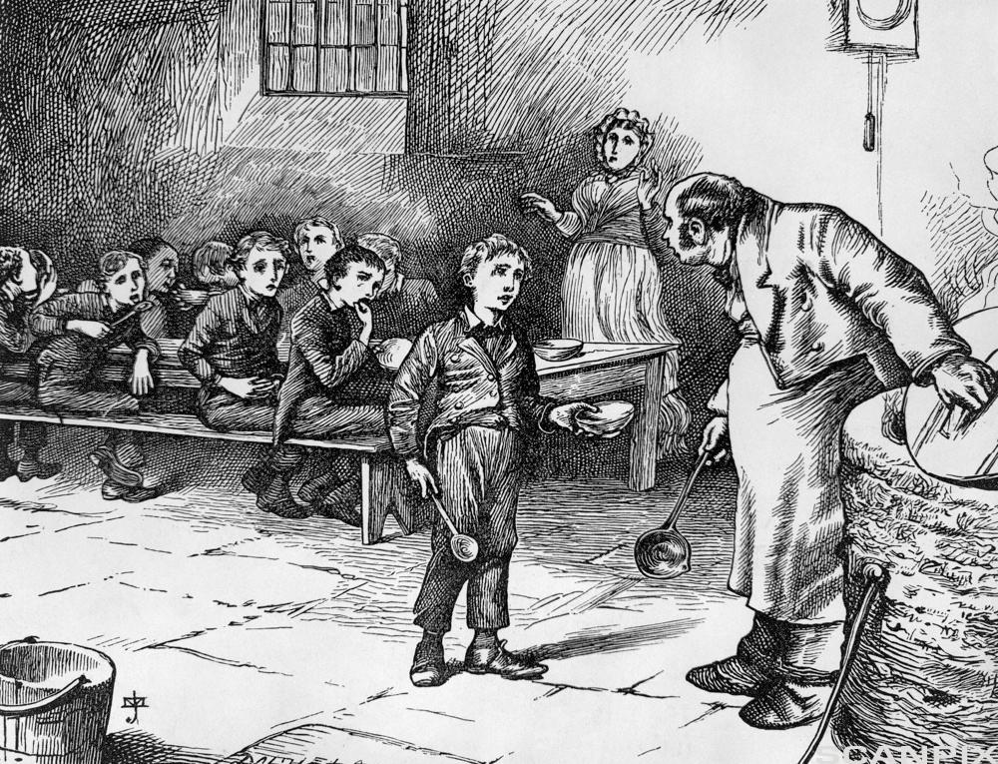
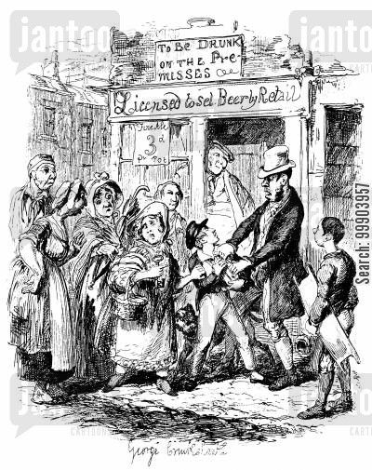
Summary შინაარსი

Slide 7
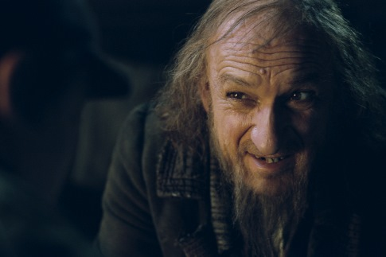
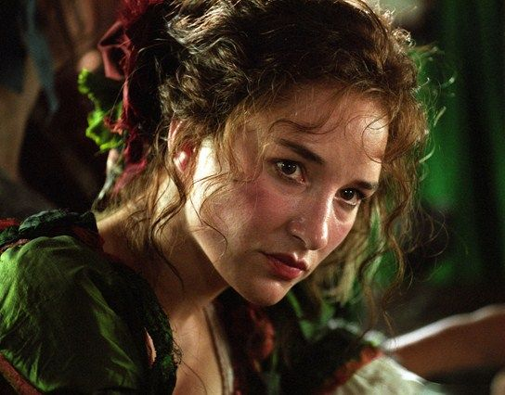
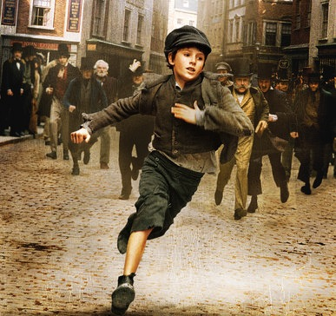
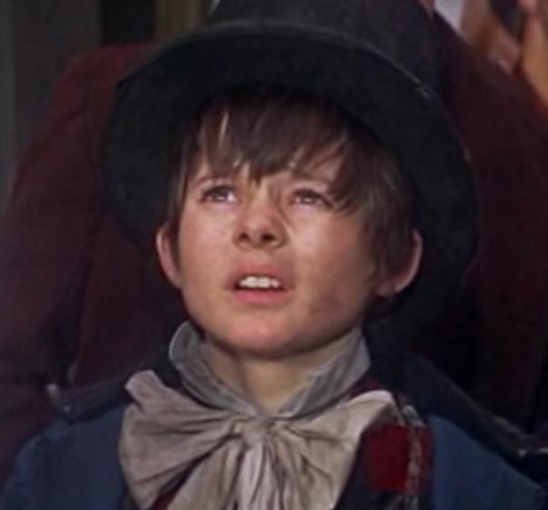
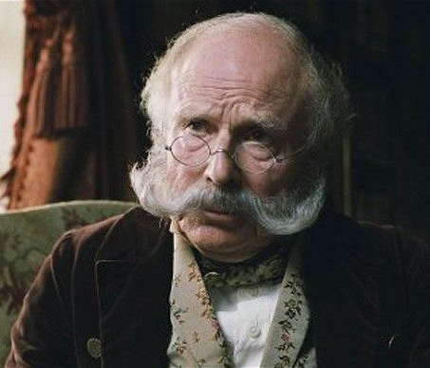
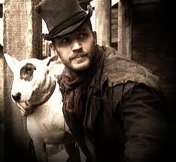
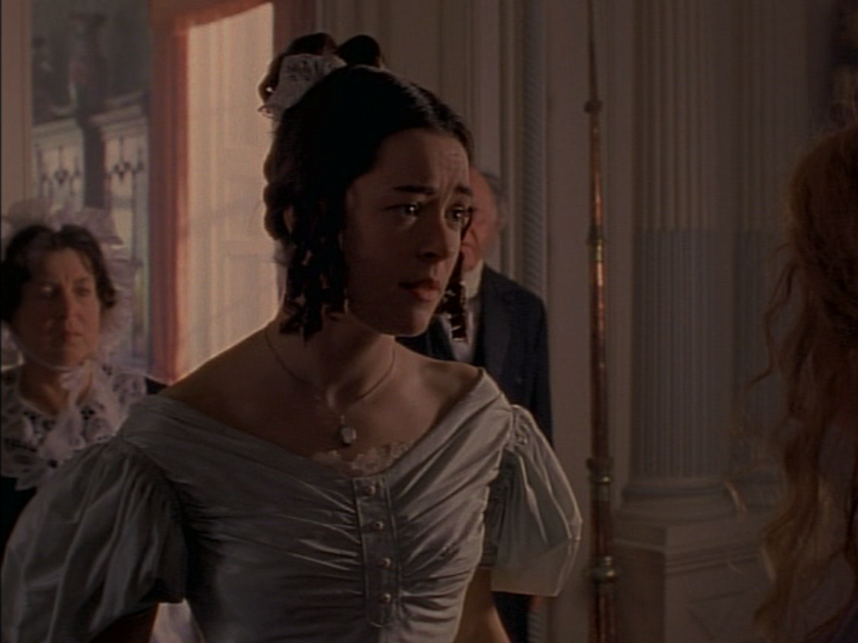
Characters
Nancy
Fagin
Artful Dodger
Mr. Brownlow
Oliver Twist
Bill Sikes
Rose Maylie

Slide 8

Setting მოქმედების ადგილი და დრო

Slide 9
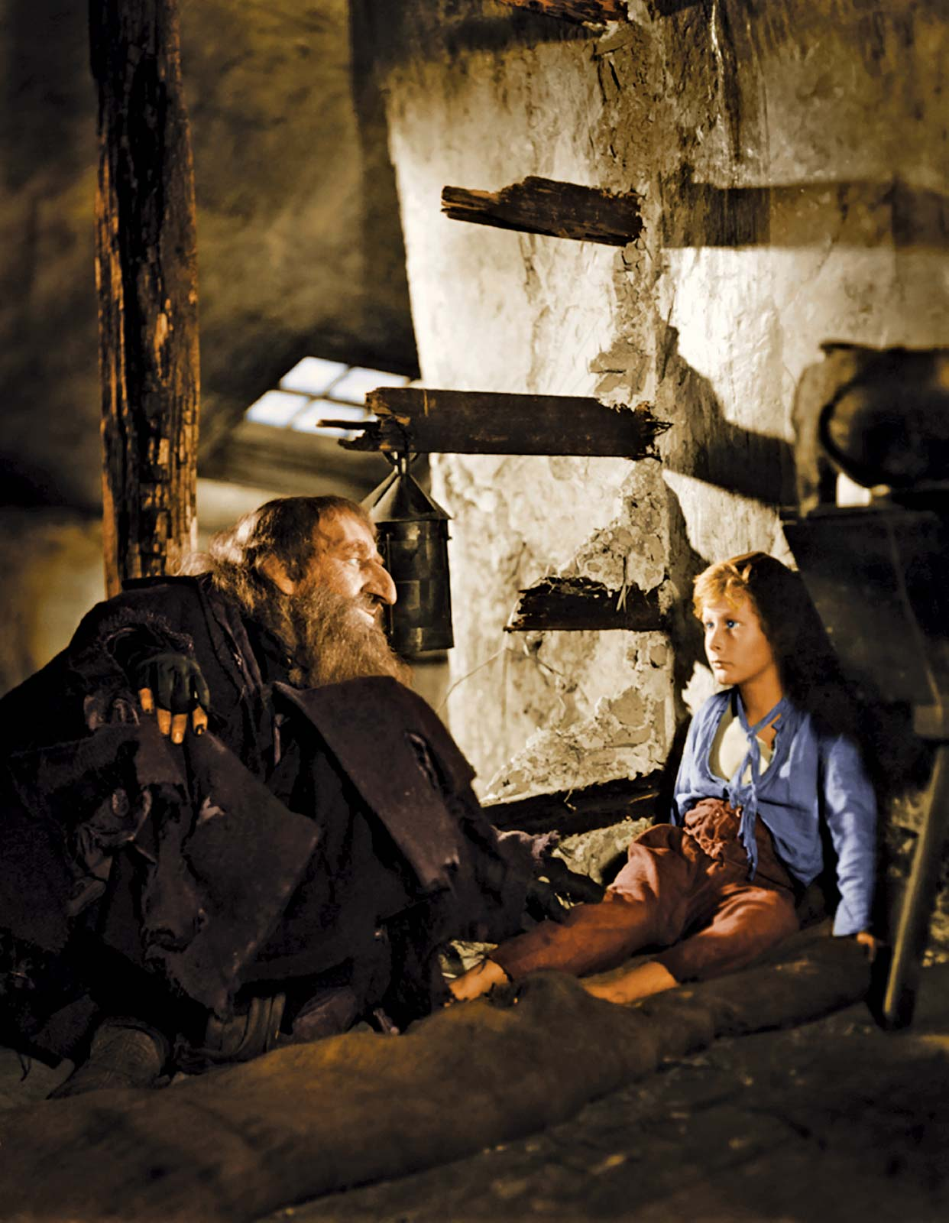
Setting is...
…the time and place (or when and where) of the story
When? | Where?

Slide 10
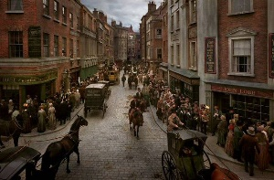
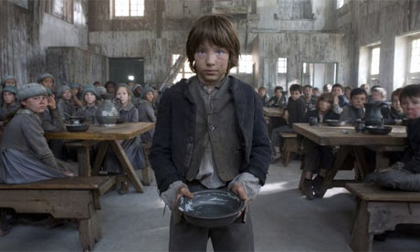
When
Early 19th century
Where
Workhouse
London, England

Slide 11
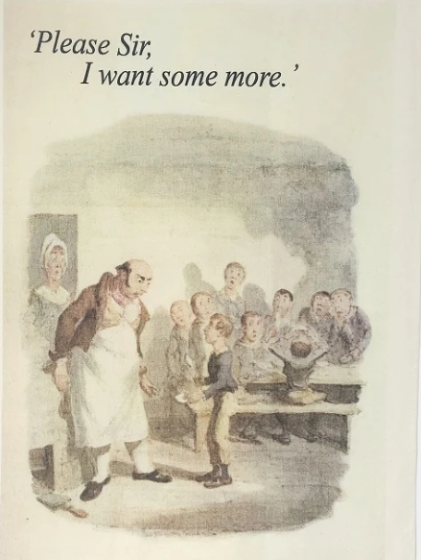
Main Themes მთავარი თემები

Slide 12
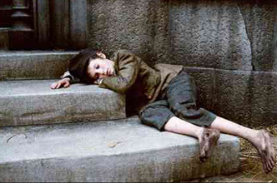
The theme of a story is what the author is trying to communicate through the characters and events — in other words, the main idea of the story.

Slide 13
Conclusion
Author
Summary
Setting
Themes
Characters
Charles Dickens
Institutional cruelty,
Injustices
The adventure of a boy who escapes from the workhouse and travels to London
London, early 19th century
Oliver Twist, Fagin, Nancy, Rose, etc.

Slide 14
Vocabulary
orphan (n.)
workhouse (n.)
poverty (n.)
A place where very poor people could live and work
a child whose parents are dead
The state of being extremely poor
charity (n.)
injustice (n.)
The voluntary giving of help; kindness and tolerance
A lack of fairness or justice
pickpocket
(n.)
cruel (adj.)
to kidnap (v.)
To take someone against their will and hold them captive
A person who steals from people’s pockets; a small-time thief
Intentionally causing pain or suffering

Slide 15
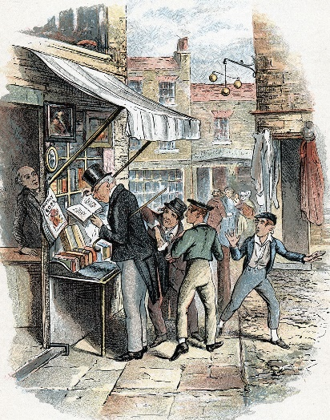
Homework
What do you think would have happened if Oliver Twist was only shown cruelty and never any charity?
What are some injustices in the world that you would like to see resolved, and how can we help fix them?
დავალება შეგიძლიათ
ატვირთოთ შემდეგ
მისამართზე:
www.englishbookeducation.co.uk/homework

