Slide 1
Mary Shelley
Frankenstein

Slide 2
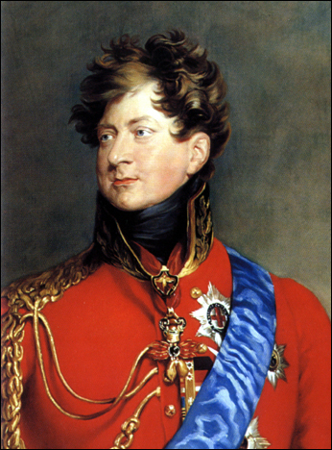
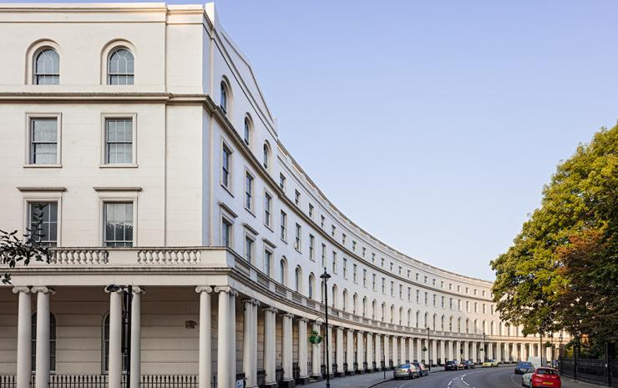
Historical Setting
The King's and Queen's Club

Slide 3
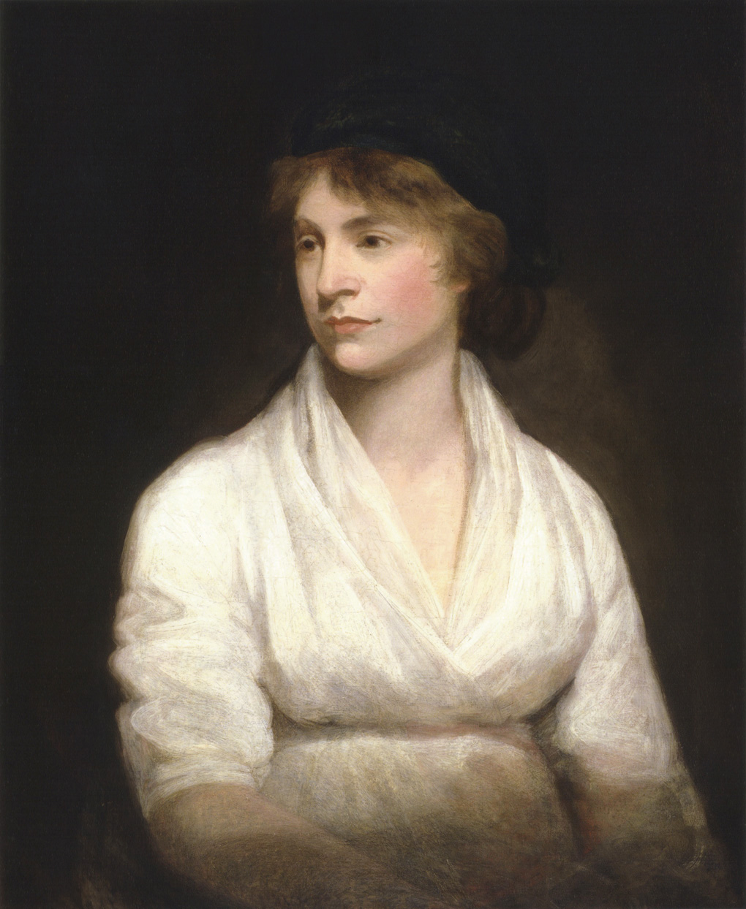
Family influence
The King's and Queen's Club

Slide 4
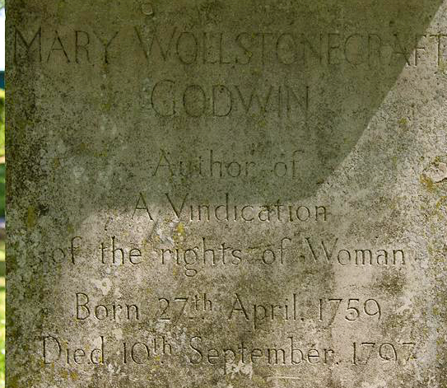
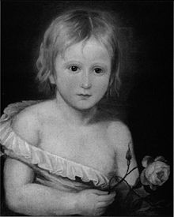
Tragedy from the very beginning
The King's and Queen's Club

Slide 5
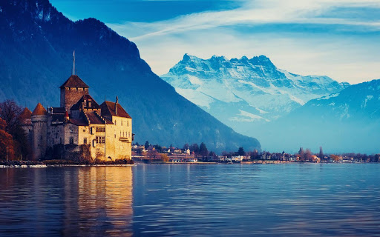
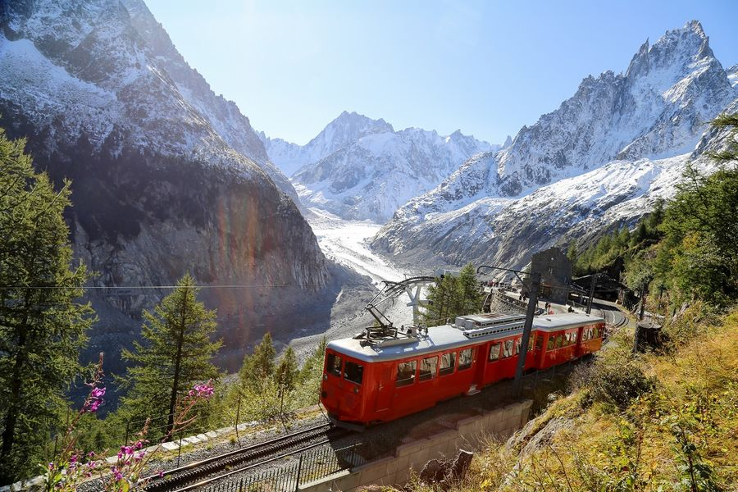
Setting and Genre
The King's and Queen's Club

Slide 6
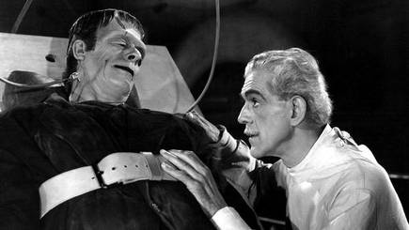
THEMES
The King's and Queen's Club

Slide 7
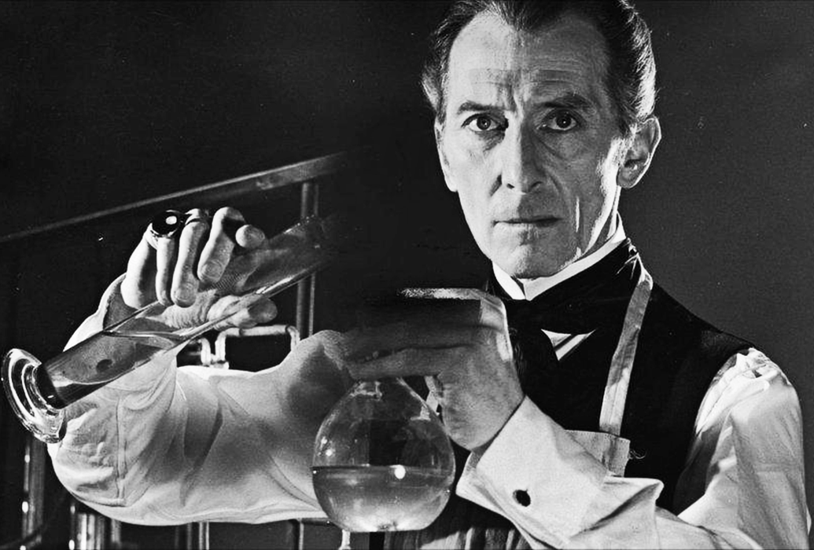
Themes
The King's and Queen's Club

Slide 8
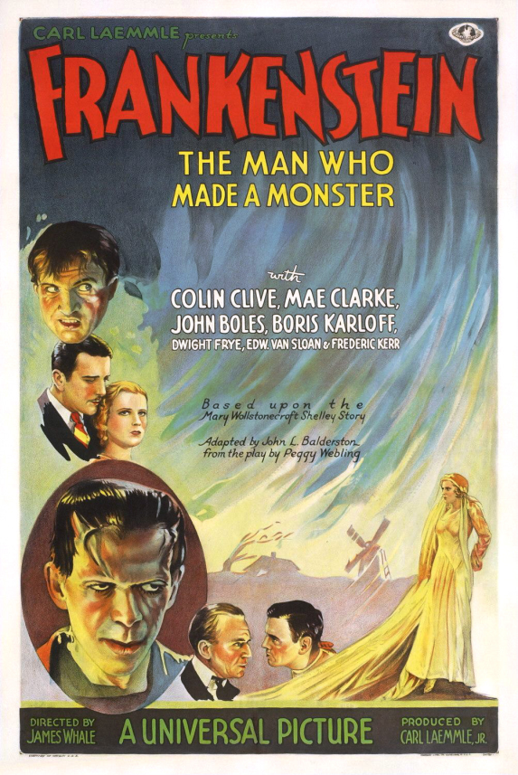
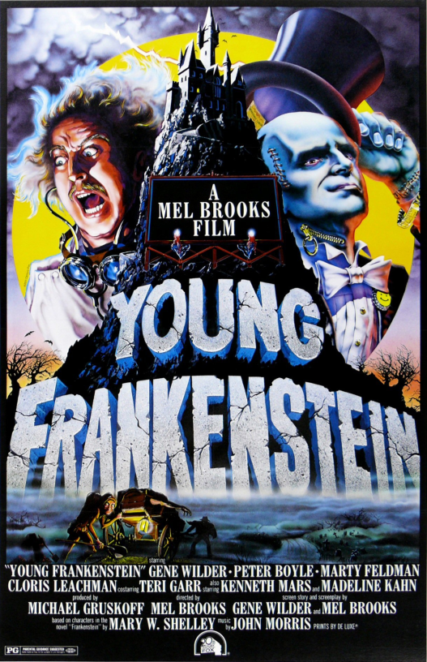
Impact
The King's and Queen's Club

Slide 9
