Slide 2
Living in a City
ქალაქში ცხოვრება
ზოგადი ინგლისური დონე: B1

Slide 3
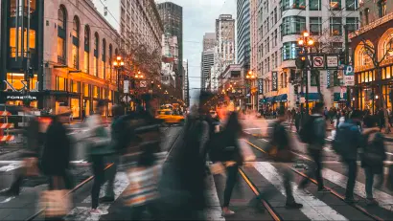
Agenda
გაკვეთილის განრიგი
Vocabulary - ლექსიკა
Reading Comprehension - წაკითხულის გააზრება
Grammar - გრამატიკა
Summary - შეჯამება
Homework - დავალება

Slide 4
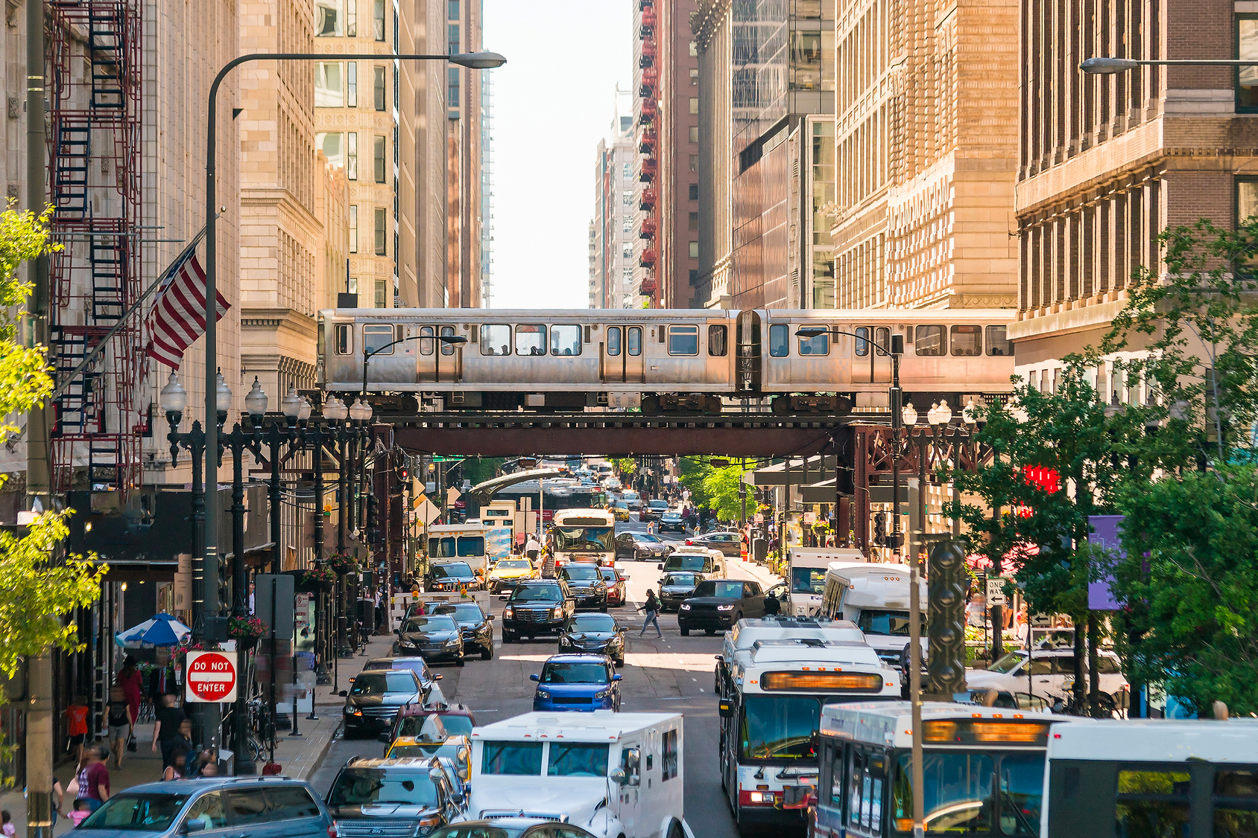
Introduction შესავალი
Do you prefer to live in a big city or a little town? Why?

Slide 5
skyscraper
(n.)
borough
(n.)
motorway
(n.)
ცათამბჯენი
პატარა ქალაქი, დაბა
ავტომაგისტრალი
Vocabulary ლექსიკა
crowded
(adj.)
suburb
(n.)
გადავსებული, სავსე
გარეუბანი
city centre
(n.)
commuting
(n.)
ქალაქის ცენტრი
მგზავრობა სახლიდან
სამსახურამდე

Slide 6
Vocabulary
ლექსიკა
skyscraper
(n.)
ცათამბჯენი

Slide 7
Vocabulary
ლექსიკა
motorway
(n.)
ავტომაგისტრალი

Slide 8
Vocabulary
ლექსიკა
suburb
(n.)
გარეუბანი

Slide 9
Vocabulary
ლექსიკა
commuting
(n.)
მგზავრობა სახლიდან
სამსახურამდე

Slide 10
Vocabulary
ლექსიკა
city centre
(n.)
ქალაქის ცენტრი

Slide 11
Vocabulary
ლექსიკა
crowded
(adj.)
გადავსებული, სავსე

Slide 12
Vocabulary
ლექსიკა
borough
(n.)
პატარა ქალაქი, დაბა

Slide 13
Vocabulary
ლექსიკა
borough
commuting
city centre
crowded
suburb
motorway
skyscraper
A town or a district in a city that is responsible for its own schools, libraries, etc

Slide 14
Vocabulary
ლექსიკა
commuting
city centre
crowded
suburb
motorway
skyscraper
In or near the centre of a town or city, especially the business or shopping areas

Slide 15
Vocabulary
ლექსიკა
commuting
crowded
suburb
motorway
skyscraper
A wide road built for fast travel between towns and cities

Slide 16
Vocabulary
ლექსიკა
commuting
crowded
suburb
skyscraper
A very tall building containing offices or flats

Slide 17
Vocabulary
ლექსიკა
commuting
crowded
suburb
To travel regularly to and from work

Slide 18
Vocabulary
ლექსიკა
crowded
suburb
Containing a lot of people, especially too many

Slide 19
Vocabulary
ლექსიკა
suburb
An area or town near a large city but away from its centre, where there are many houses, especially for middle-class people

Slide 20
populated
(adj.)
intensity
(n.)
loud
(adj.)
დასახლებული
სიძლიერე,
ინტენსივობა
ხმამაღალი, ხმაურიანი
Vocabulary ლექსიკა
modern
(adj.)
colourful
(adj.)
თანამედროვე
ფერადი
world-class
(adj.)
marvellous
(adj.)
გასაოცარი
მსოფლიო დონის

Slide 21
Vocabulary
ლექსიკა
populated
(adj.)
დასახლებული

Slide 22
Vocabulary
ლექსიკა
intensity
(n.)
სიძლიერე, ინტენსივობა

Slide 23
Vocabulary
ლექსიკა
modern
(adj.)
თანამედროვე

Slide 24
Vocabulary
ლექსიკა
world-class
(adj.)
მსოფლიო დონის

Slide 25
Vocabulary
ლექსიკა
marvellous
(adj.)
გასაოცარი

Slide 26
Vocabulary
ლექსიკა
colourful
(adj.)
ფერადი

Slide 27
Vocabulary
ლექსიკა
loud
(adj.)
ხმამაღალი, ხმაურიანი

Slide 28
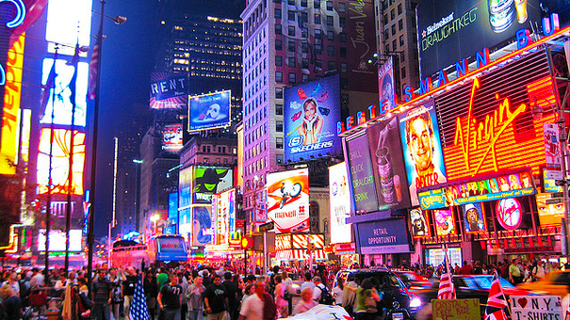
Reading Comprehension
წაკითხულის გააზრება
If you could choose in which city would you live? Why?

Slide 29
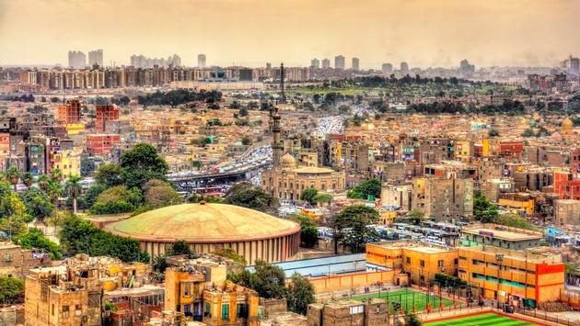
Reading Comprehension
წაკითხულის გააზრება
Rio de Janeiro
Cairo
Kuala Lumpur
Paris
This is a loud and heavily populated city. It's an unpredictable place, absolutely full of people with a real intensity about it: you will either love it or hate it. New tower blocks stand next to traditional houses made of sun-baked mud, with some of the oldest and most famous monuments in the world visible from the city centre. Why try and be so modern when your city is famous for having something so old?

Slide 30
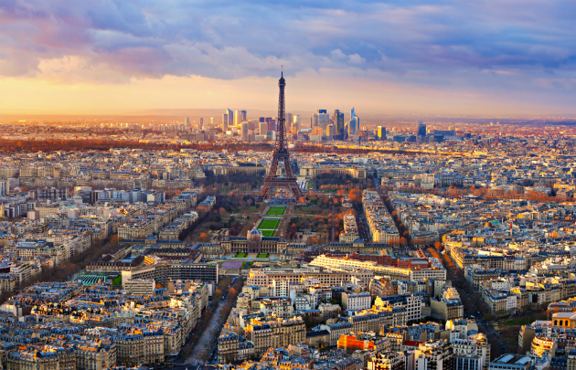
Reading Comprehension
წაკითხულის გააზრება
Rio de Janeiro
Cairo
Kuala Lumpur
Paris
A place of world-class food, museums and architecture and considered the most romantic city in the world by some, this capital city demands to be photographed, painted and enjoyed by the young and not-so-young alike. Lights upon the river at night attract couples from all over the world to honeymoon or rediscover their love for one another. And for art lovers, it is home to some of the finest masterpieces in the world. Visiting all of the city's museums would take at least a month.

Slide 31
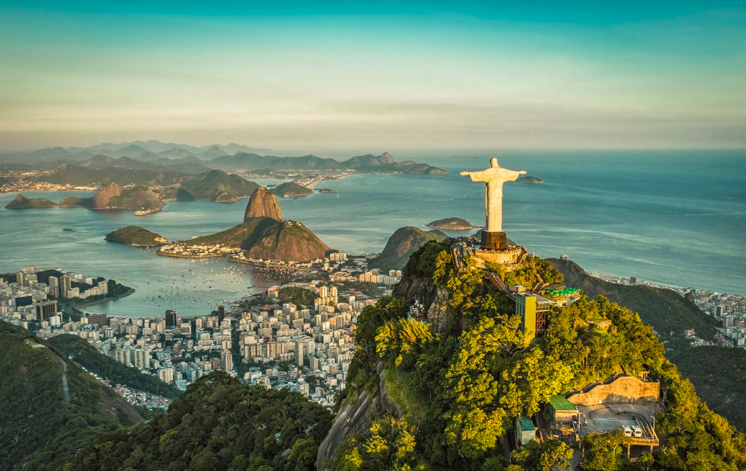
Reading Comprehension
წაკითხულის გააზრება
Rio de Janeiro
Cairo
Kuala Lumpur
Paris
Known locally as the 'marvellous city', it attracts visitors looking for a good time. Famous for its carnival and spectacular location on the coast, this populous city always has room for a few more visitors in its hotels. The locals are fanatical about sport so head down to the beach for a game of football in the sand and see if you can spot any celebrities.

Slide 32
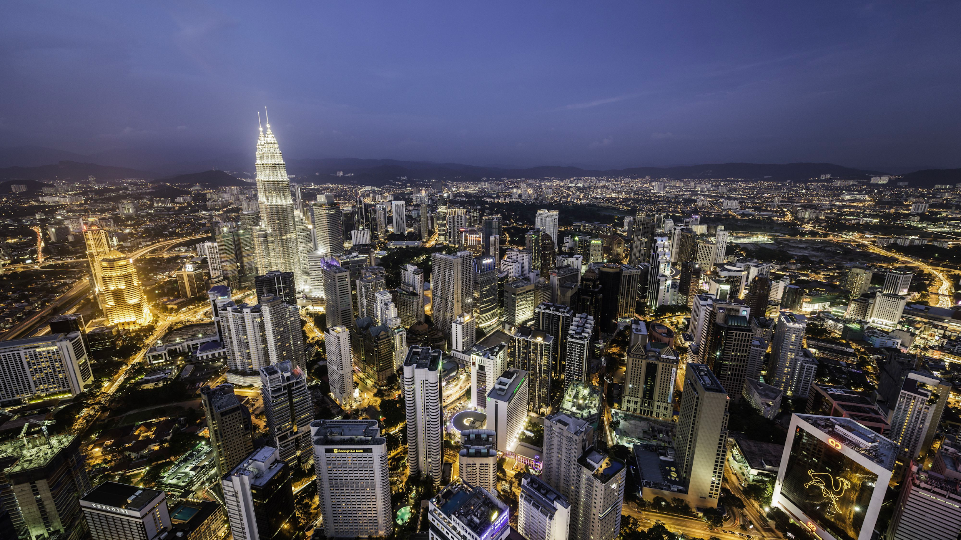
Reading Comprehension
წაკითხულის გააზრება
Rio de Janeiro
Cairo
Kuala Lumpur
Paris
Home to almost 2 million people, this lively, colourful capital has been built up from virtually nothing in 130 years. It is currently home to one of the tallest buildings in the world, comprised of two huge towers as well as many modern buildings crafted with an Islamic flavour to their design. Tradition has not been forgotten here, though, as is evidenced in the thriving night markets and street life in the city.

Slide 33
Reading Comprehension
წაკითხულის გააზრება
Answer the questions based on the text.
უპასუხეთ მოცემულ კითხვებს ტექსტზე დაყრდნობით.
Which city is one of the most romantic cities in the world?
Paris
A place of world-class food, museums and architecture and considered the most romantic city in the world.

Slide 34
Reading Comprehension
წაკითხულის გააზრება
Answer the questions based on the text.
უპასუხეთ მოცემულ კითხვებს ტექსტზე დაყრდნობით.
2. Which city is the home for one of the tallest buildings in the world?
Kuala Lumpur
It is currently home to the tallest buildings in the world, comprised of two huge towers as well as many modern buildings crafted with an Islamic flavour to their design.

Slide 35
Reading Comprehension
წაკითხულის გააზრება
Answer the questions based on the text.
უპასუხეთ მოცემულ კითხვებს ტექსტზე დაყრდნობით.
3. Which city is not predictable, colourful and intense?
Cairo
This is a loud and heavily populated city. It's an unpredictable place, absolutely full of people with a real intensity about it.

Slide 36
Reading Comprehension
წაკითხულის გააზრება
Answer the questions based on the text.
უპასუხეთ მოცემულ კითხვებს ტექსტზე დაყრდნობით.
4. Which city is marvellous and known for its carnavals?
Rio de Janeiro
Famous for its carnival and spectacular location on the coast, this populous city always has room for a few more visitors in its hotels.

Slide 37
Grammar
გრამატიკა
Present Perfect Continuous - აწმყო სრული განგრძობითი დრო
Present Perfect Continuous is used to put emphasis on the duration of an action which started in the past and continues up to the present, especially with time expressions such as for, since, all morning/day.
I have been searching for the shop for three hours.

Slide 38
Grammar
გრამატიკა
Present Perfect Continuous - აწმყო სრული განგრძობითი დრო
Present Perfect Continuous is used for an action which started and finished in the past and lasted for some time. The result of the action is visible in the present.
The town looks very modern. It has been renovating for years .

Slide 39
Grammar
გრამატიკა
Present Perfect Continuous - აწმყო სრული განგრძობითი დრო
With verbs feel (have a particular emotion), live, work, and teach we can use the Present Perfect Simple with no difference in meaning.
He has felt/has been feeling sick all afternoon.

Slide 40
Grammar
გრამატიკა
Present Perfect Continuous - აწმყო სრული განგრძობითი დრო
Present Perfect Continuous is used to express anger, annoyance, and irritation.
Who has been using my toothbrush?

Slide 41
Grammar
გრამატიკა
Present Perfect Continuous - აწმყო სრული განგრძობითი დრო
Present Perfect Continuous is used with the following time expressions: how long; for; since; lately.
I have been writing this exercise since yesterday.

Slide 42
Grammar
გრამატიკა
Present Perfect Continuous - აწმყო სრული განგრძობითი დრო
Present Perfect Continuous is formed with the help of the verb have + past participle of the verb to be + verb+ing
I have been reading books since childhood/ Have I been reading books since childhood?/ I haven’t been reading books since childhood.

Slide 43
Grammar
გრამატიკა
Fill in the correct form of Present Perfect Simple or Present Perfect Continuous.
გამოიყენეთ აწმყო სრული ან აწმყო სრული განგრძობითი დრო.
I am so tired, I ........(work) so hard lately.
I am so tired, I have been working so hard lately.

Slide 44
Grammar
გრამატიკა
Fill in the correct form of Present Perfect Simple or Present Perfect Continuous.
გამოიყენეთ აწმყო სრული ან აწმყო სრული განგრძობითი დრო.
.........(finish) reading the book? Could you give it to me please?
Have you finished reading the book? Could you give it to me please?

Slide 45
Grammar
გრამატიკა
Fill in the correct form of Present Perfect Simple or Present Perfect Continuous.
გამოიყენეთ აწმყო სრული ან აწმყო სრული განგრძობითი დრო.
Where is my key? I .........(search) it for hours.
Where is my key? I have been searching it for hours.

Slide 46
Grammar
გრამატიკა
Fill in the correct form of Present Perfect Simple or Present Perfect Continuous.
გამოიყენეთ აწმყო სრული ან აწმყო სრული განგრძობითი დრო.
I ........(change) all my passwords recently, but I forgot to write them down.
I have changed all my passwords recently, but I forgot to write them down.

Slide 47
Summary
გაკვეთილის შეჯამება
Vocabulary
Living in a City
ქალაქში ცხოვრება
Reading about cities
Grammar: Present Perfect Continuous

Slide 48
Homework
საშინაო დავალება
Write a short paragraph about your favourite city.
დაწერეთ მოკლე აბზაცი თქვენი საყვარელი ქალაქის შესახებ.

Slide 49
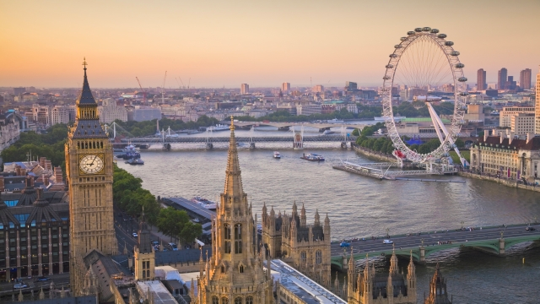
Homework
საშინაო დავალება
My dream city where I would like to live is London. This a diverse city . You meet people of any nationality here. The museums are amazing. You can go sightseeing everyday and see something new. Of course, as any other city, this one is crowded as well, but on the other hand, you can learn about cultural differences here. I have been dreaming of visiting London Eye and the Buckingham Palace. I really hope I will live there one day.

