Slide 1
David Copperfield
By Charles Dickens
Grades 10-12

Slide 2
Agenda
Vocabulary - ლექსიკა
Main themes - მთავარი თემები
Conclusion and Homework - შეჯამება და დავალება
About the Author- ავტორის შესახებ
Summary - შინაარსი
Characters - გმირები
Setting - მოქმედების ადგილი და დრო

Slide 3
Vocabulary
narrator
(n.)
to mature
(v.)
bildungsroman (n.)
The character who tells the events of a story
A novel following the protagonist’s moral growth throughout life
To become fully grown or developed
to abuse
(v.)
to reminisce
(v.)
To remember past events with pleasure
To treat cruelly and cause harm
corrupt
(adj.)
incompetent (adj.)
to manipulate (v.)
Willing to act dishonestly for money or power
Unskilled, unqualified
To control a person or situation; to deceive

Slide 4
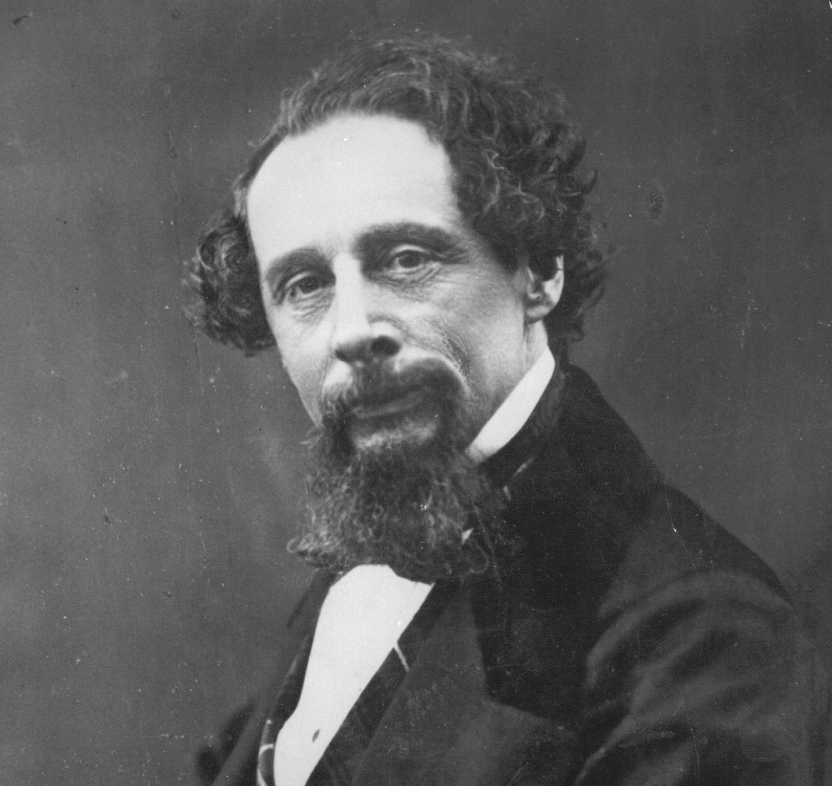
About the Author

Slide 5
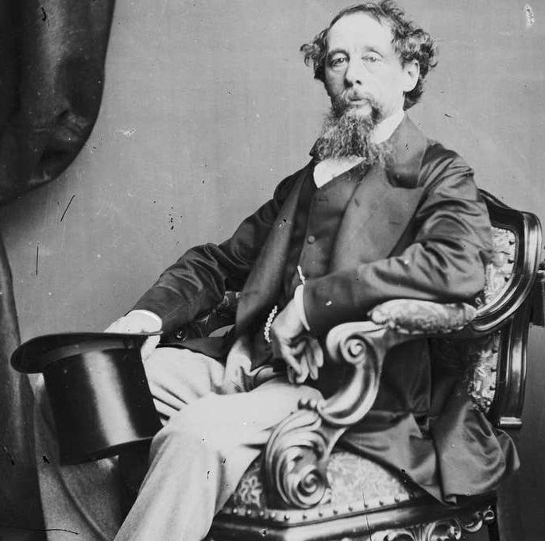
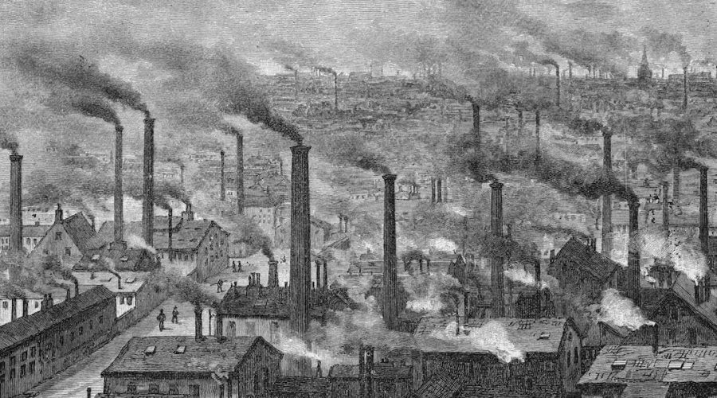
Charles Dickens
1812 – 1870
Portsmouth, England

Slide 6
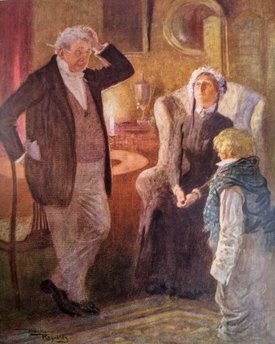
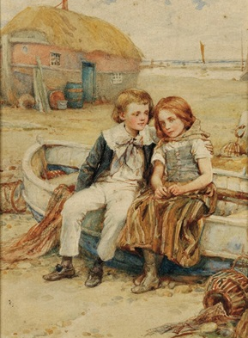
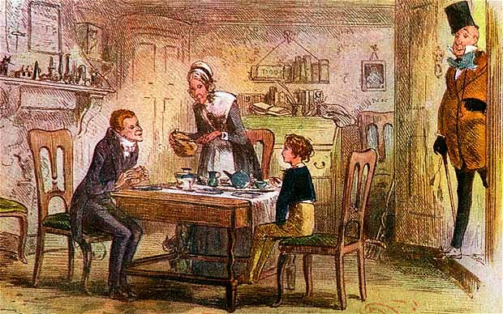
Summary შინაარსი

Slide 7
Characters
David Copperfield
Betsey Trotwood
Wilkins Micawber
Mr. Wickfield
Uriah Heep
Dora
Agnes

Slide 8
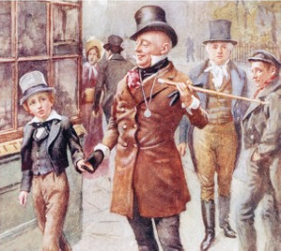
Setting მოქმედების ადგილი და დრო

Slide 9
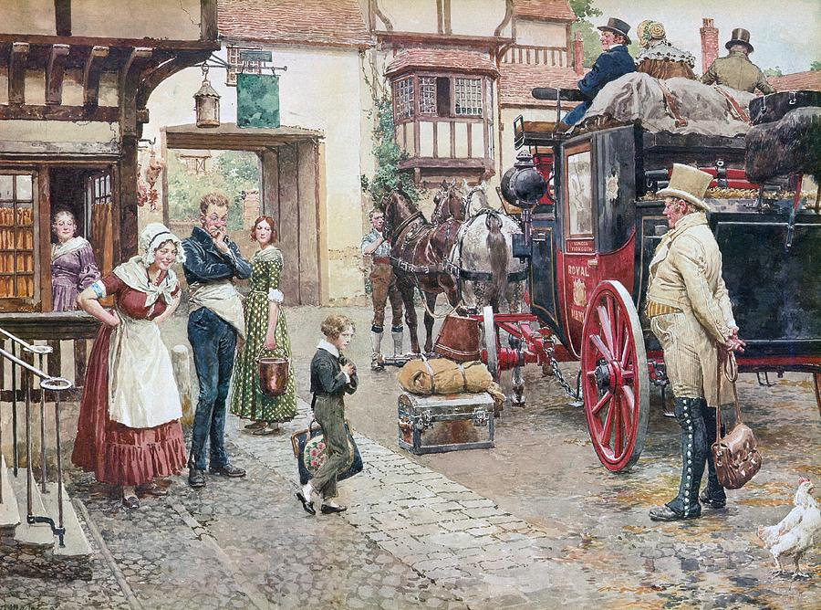
Setting is...
…the time and place (or when and where) of the story
When? | Where?

Slide 10
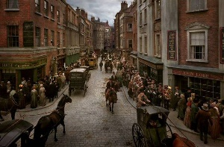
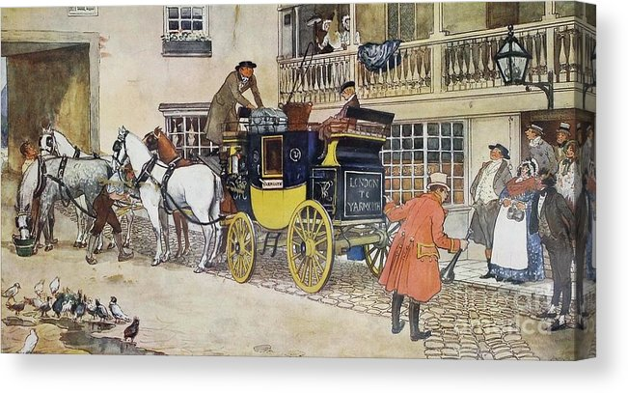
When
Early 19th century
Where
England
Blunderstone
Yarmouth
Dover
Canterbury
London

Slide 11
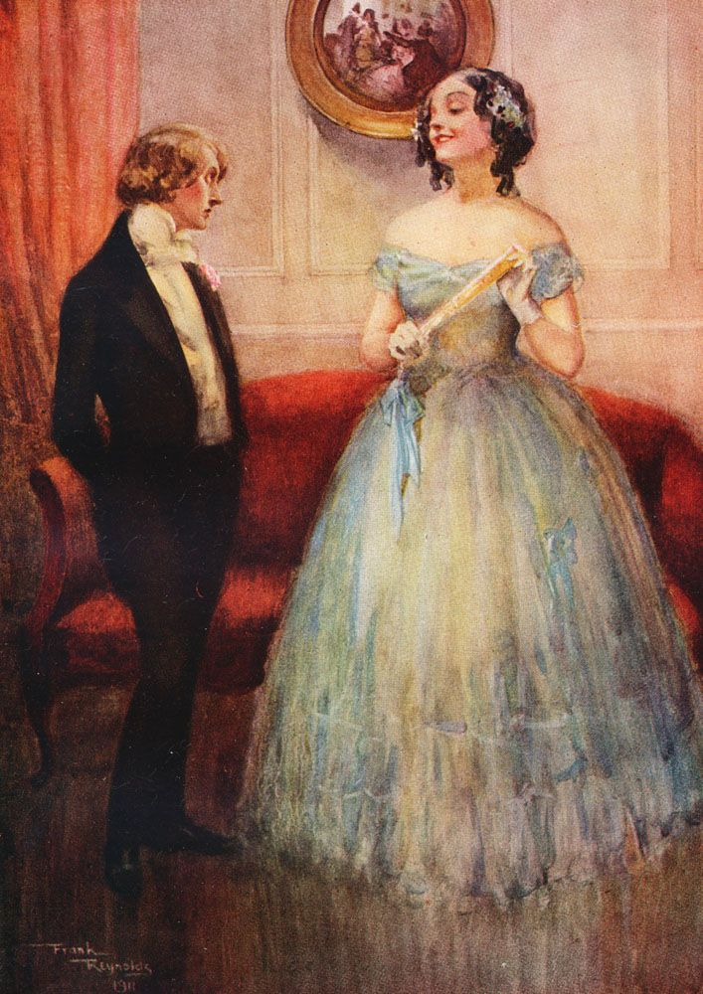
Main Themes მთავარი თემები

Slide 12
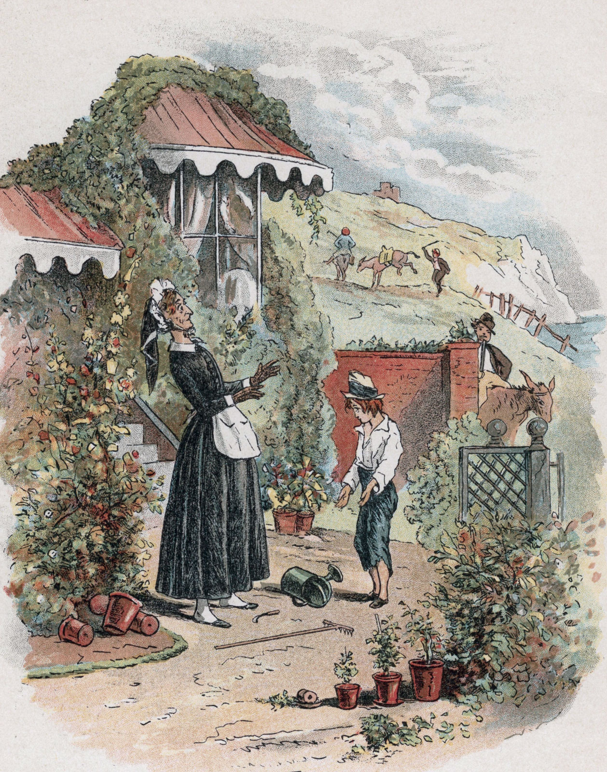
The theme of a story is what the author is trying to communicate through the characters and events — in other words, the main idea of the story.

Slide 13
Conclusion
Author
Summary
Setting
Themes
Characters
Charles Dickens
Bildungsroman
The life of David Copperfield from the time of his birth to his mature manhood
Early 19th Century;
England
David Copperfield, Betsey Trotwood, Uriah Heep, Agnes, Dora, etc.

Slide 14
Vocabulary
narrator
(n.)
to mature
(v.)
bildungsroman (n.)
The character who tells the events of a story
A novel following the protagonist’s moral growth throughout life
To become fully grown or developed
to abuse
(v.)
to reminisce
(v.)
To remember past events with pleasure
To treat cruelly and cause harm
corrupt
(adj.)
incompetent (adj.)
to manipulate (v.)
Willing to act dishonestly for money or power
Unskilled, unqualified
To control a person or situation; to deceive

Slide 15
Homework
Imagine you are middle-aged, reminiscing about your past. Write a short Bildungsroman story, focusing on the important experiences throughout your life and how they shaped you into the middle-aged adult you are.
დავალება შეგიძლიათ
ატვირთოთ შემდეგ
მისამართზე:
www.englishbookeducation.co.uk/homework

