Slide 2
Superstitions
ცრურწმენები
ზოგადი ინგლისური დონე: B1+

Slide 3
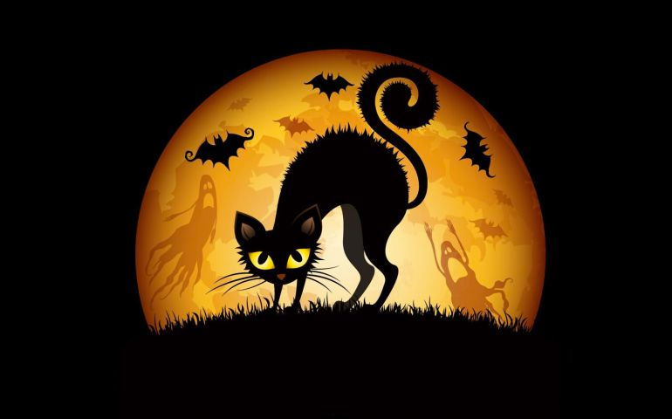
Agenda
გაკვეთილის განრიგი
Vocabulary - ლექსიკა
Reading Comprehension - წაკითხულის გააზრება
Grammar - გრამატიკა
Summary - შეჯამება
Homework - დავალება

Slide 4
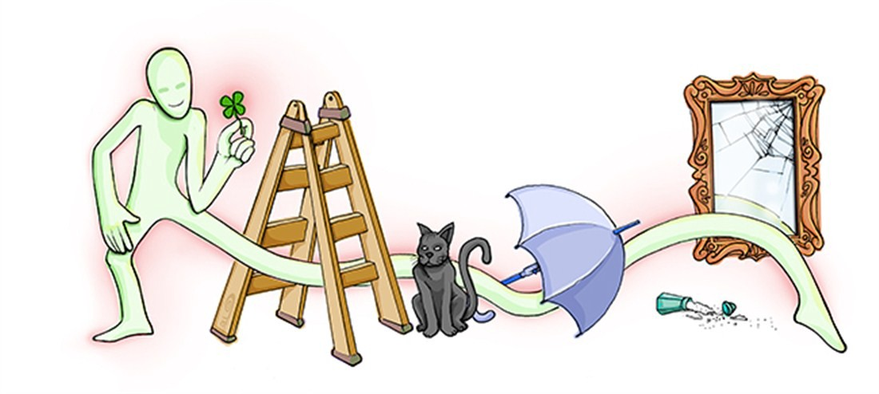
Introduction
შესავალი
Are you superstitious? Do you believe that there are things which bring good or bad luck?

Slide 5
superstitious
(adj.)
jinx
(v.)
ghost
(n.)
ცრუმორწმუნე
უბედურების მოტანა
მოჩვენება
Vocabulary ლექსიკა
belief
(n.)
proof
(n.)
რწმენა
მტკიცებულება
gullible
(adj.)
ritual
(n.)
გულუბრყვილო, მიამიტი
რიტუალი

Slide 6
Vocabulary
ლექსიკა
superstitious
(adj.)
ცრუმორწმუნე

Slide 7
Vocabulary
ლექსიკა
ghost
(n.)
მოჩვენება

Slide 8
Vocabulary
ლექსიკა
belief
(n.)
რწმენა

Slide 9
Vocabulary
ლექსიკა
ritual
(n.)
რიტუალი

Slide 10
Vocabulary
ლექსიკა
proof
(n.)
მტკიცებულება

Slide 11
Vocabulary
ლექსიკა
gullible
(adj.)
გულუბრყვილო, მიამიტი

Slide 12
Vocabulary
ლექსიკა
jinx
(v.)
უბედურების მოტანა

Slide 13
Vocabulary
ლექსიკა
superstitious
ghost
belief
ritual
gullible
proof
jinx
This kind of person is easy to trick because he/she trusts and believes people too easily

Slide 14
Vocabulary
ლექსიკა
superstitious
ghost
belief
ritual
proof
jinx
Something that you do regularly and always in the same way

Slide 15
Vocabulary
ლექსიკა
superstitious
ghost
belief
proof
jinx
Information or evidence that shows that something is definitely true or definitely exists

Slide 16
Vocabulary
ლექსიკა
superstitious
ghost
belief
jinx
A force that brings bad luck and often affects someone or something

Slide 17
Vocabulary
ლექსიკა
superstitious
ghost
belief
A belief that things such as magic or luck have the power to affect your life

Slide 18
Vocabulary
ლექსიკა
ghost
belief
The spirit of a dead person that someone can see or hear

Slide 19
Vocabulary
ლექსიკა
belief
A strong feeling that something is true or real

Slide 20
novice
(n.)
grinding
(n.)
newbies
(n.)
სიახლე
დაფქვა, დანაყვა
ახალბედა
trap
(n.)
Vocabulary ლექსიკა
hamper
(v.)
ხაფანგი
ხელის შეშლა, დაბრკოლება
doom
(v.)
surefire
(adj.)
განწირვა
უტყუარი

Slide 21
Vocabulary
ლექსიკა
novice
(n.)
სიახლე

Slide 22
Vocabulary
ლექსიკა
newbies
(n.)
ახალბედა

Slide 23
Vocabulary
ლექსიკა
hamper
(v.)
ხელის შეშლა, დაბრკოლება

Slide 24
Vocabulary
ლექსიკა
surefire
(adj.)
უტყუარი

Slide 25
Vocabulary
ლექსიკა
doom
(v.)
განწირვა

Slide 26
Vocabulary
ლექსიკა
trap
(n.)
ხაფანგი

Slide 27
Vocabulary
ლექსიკა
grinding
(n.)
დაფქვა, დანაყვა

Slide 28
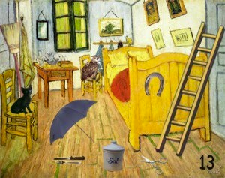
Reading Comprehension
წაკითხულის გააზრება
Are there any other superstitions in your country? Do your family have their own superstitions? If so, what are they?

Slide 29
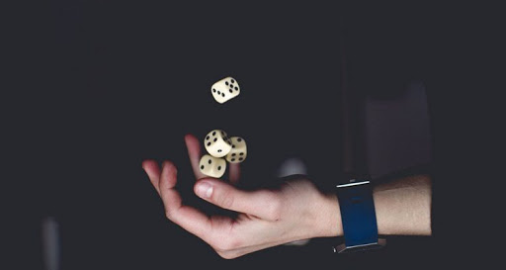
Reading Comprehension
წაკითხულის გააზრება
Beginners Luck
Usually grumbled by an expert who just lost a game to a novice, "beginner's luck" is the idea that newbies are unusually likely to win when they try out a sport, game or activity for the first time.
Beginners might come out ahead in some cases because the novice is less stressed out about winning. Too much anxiety, after all, can hamper performance. Or it could just be a statistical fluke.
Or, like many superstitions, a belief in beginner's luck might arise because of confirmation bias. Confirmation bias is a psychological phenomenon in which people are more likely to remember events that fit their worldview. If you believe you're going to win because you're a beginner, you're more likely to remember all the times you were right — and forget the times you ended up in last place.

Slide 30
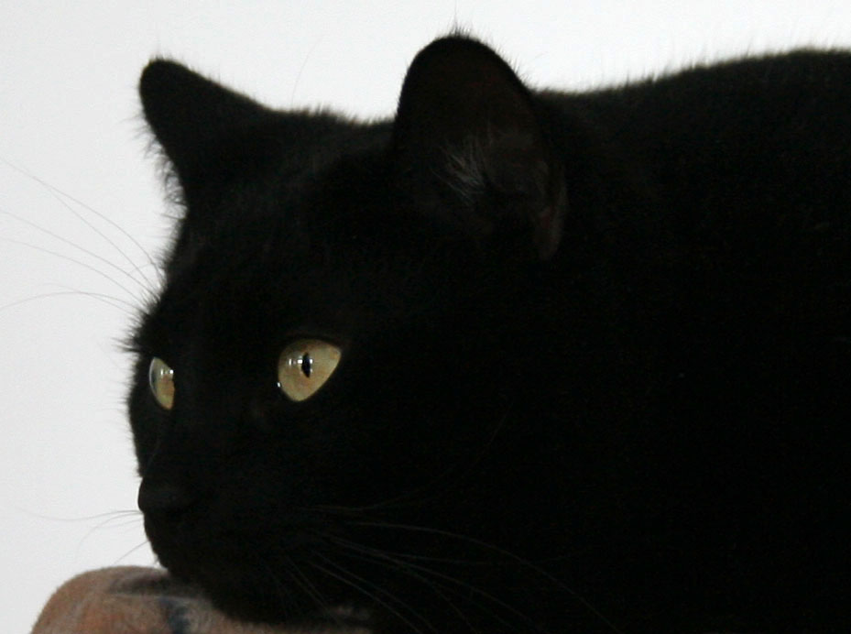
Reading Comprehension
წაკითხულის გააზრება
Black cats crossing your path
As companion animals for humans for thousands of years, cats play all sorts of mythological roles. In ancient Egypt, cats were revered; today, Americans collectively keep more than 81 million cats as pets.
So why keep a black cat out of your path? Most likely, this superstition arises from old beliefs in witches and their animal familiars, which were often said to take the form of domestic animals like cats.

Slide 31
Reading Comprehension
წაკითხულის გააზრება
Mirror
According to folklore, breaking a mirror is a surefire way to doom yourself to seven years of bad luck. The superstition seems to arise from the belief that mirrors don't just reflect your image; they hold bits of your soul. That belief led people in the old days of the American South to cover mirrors in a house when someone died, lest their soul be trapped inside.
Like the number three, the number seven is often associated with luck. Seven years is a long time to be unlucky, which may be why people have come up with counter-measures to free themselves after breaking a mirror. These include touching a piece of the broken mirror to a tombstone or grinding the mirror shards into powder.

Slide 32
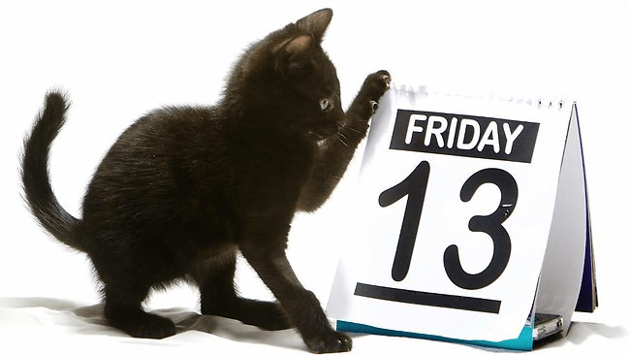
Reading Comprehension
წაკითხულის გააზრება
Friday the 13th:
For a superstition, the fear of Friday the 13th seems fairly new, dating back to the late 1800s. Friday has long been considered as an unlucky day (according to Christian tradition, Jesus died on Friday), and 13 has a long history as an unlucky number.
According to the Stress Management Center and Phobia Institute in North Carolina, about 17 million people fear Friday the 13th. Many may fall prey to the human mind's desire to associate thoughts and symbols with events.
"If anything bad happens to you on Friday the 13th, the two will be forever associated in your mind," said a psychologist at Cornell University. "All those uneventful days in which the 13th fell on a Friday will be ignored."

Slide 33
Reading Activity
კითხვის დავალება
Answer the given questions.
უპასუხეთ მოცემულ შეკითხვებს.
1. Is it beginner’s luck when you practise a lot and eventually succeed ?
No, it is when a newbie plays a sport or a game for the first time and wins.

Slide 34
Reading Activity
კითხვის დავალება
Answer the given questions.
უპასუხეთ მოცემულ შეკითხვებს.
2. Were white cats seen as bad luck?
No, black cats are seen as bad luck from old beliefs that they are witches' familiars.

Slide 35
Reading Activity
კითხვის დავალება
Answer the given questions.
უპასუხეთ მოცემულ შეკითხვებს.
3. Is it true that if you break a mirror, you receive seven years of bad luck?
Yes, and you reverse this curse by touching a piece of the glass to a tombstone or grinding up the mirror shards into powder.

Slide 36
Reading Activity
კითხვის დავალება
Answer the given questions.
უპასუხეთ მოცემულ შეკითხვებს.
4. Is Friday the 13th considered as an unlucky day?
Yes, because 13 is considered an unlucky number and this dates back to the 1800s.

Slide 37
Grammar
გრამატიკა
Reported Speech
ირიბი თქმა
We can report people’s words by using direct speech or reported speech.
In case of direct speech we use someone’s exact words. We use quotation marks in direct speech.
Reported speech is the exact meaning of what someone said, but not the exact words. We do not use quotation marks in reported speech. We can either use the word that after the introductory verbs (say, tell, etc.) or we can omit it.

Slide 38
Grammar
გრამატიკა
Reported Speech
ირიბი თქმა
In reported speech personal pronouns, possessive adjectives/possessive pronouns change according to the meaning of the sentence.
Sophie said: “I am leaving for England with my family tomorrow”.
Sophie said that she was leaving for England with her family the following day.

Slide 39
Grammar
გრამატიკა
Reported Speech
ირიბი თქმა
We can use say and tell both in direct and reported speech.
Tell is always followed by a personal object (told me).
Say is used with or without a personal object. When used with a personal object it is always followed by the preposition to (said to me).
He said: “I’m George”.
He said that he was George .
He said to me: “I’m George”.
He said to me that he was George.

Slide 40
Grammar
გრამატიკა
Reported Speech
ირიბი თქმა
We can report someone’s words either a long time after they were said (out-of-date-reporting) or immediately after they were said (up-to-date-reporting).

Slide 41
Grammar
გრამატიკა
Reported Speech
ირიბი თქმა
We usually report someone’s words after they were said. In this case, the introductory verb is in Past Simple and the tense changes as follows:
Direct speech | Reported speech
Present Simple | Past Simple
Present Continuous | Past Continuous
Past Simple | Past Simple or Past Perfect
Past Continuous | Past Continuous or Past Perfect Continuous
Future (will) | Conditional (would)

Slide 42
Grammar
გრამატიკა
Reported Speech
ირიბი თქმა
Certain words and time expressions change according to the meaning of the sentence, as follows:
Now - then, at that time
Today, tonight - that day, that night
Yesterday - the day before, the previous day
Tomorrow - the next day, the following day
This week - that week
Last week - the week before, the previous week
Next week - the week after, the following week
Two days ago - two days before
Here - there
Come - go

Slide 43
Grammar
გრამატიკა
Reported Speech
ირიბი თქმა
When this/these are used in time expressions, they change to that/those.
This week - that week
These days - those days

Slide 44
Grammar
გრამატიკა
Rewrite the sentences in Reported Speech.
გადაიყვანეთ წინადადებები ირიბ თქმაში.
1. Tom said: "He works in a bank."
Tom said that he worked in a bank.

Slide 45
Grammar
გრამატიკა
Rewrite the sentences in Reported Speech.
გადაიყვანეთ წინადადებები ირიბ თქმაში.
2. She said: "I have never been there before."
She said that she had never been there before.

Slide 46
Grammar
გრამატიკა
Rewrite the sentences in Reported Speech.
გადაიყვანეთ წინადადებები ირიბ თქმაში.
3. Anna said: "She's living in Paris for a few months."
Anna said that she was living in Paris for a few months.

Slide 47
Grammar
გრამატიკა
Rewrite the sentences in Reported Speech.
გადაიყვანეთ წინადადებები ირიბ თქმაში.
4. She said: "I'll do the washing-up later."
She said that she would do the washing-up later.

Slide 48
Summary
გაკვეთილის შეჯამება
Superstition
ცრურწმენები
Vocabulary
Reading about Superstitions
Grammar: Reported Speech

Slide 49
Homework
საშინაო დავალება
Write a short paragraph about your country’s superstitions.
დაწერეთ აბზაცი იმის შესახებ, თუ რა ცრურწმენებია გავრცელებული თქვენს ქვეყანაში.

Slide 50
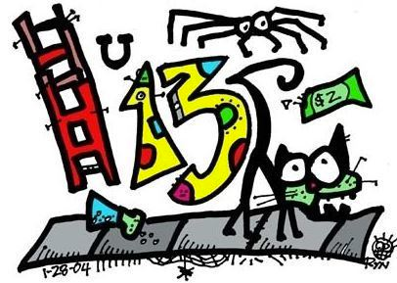
Homework
საშინაო დავალება
In America, there are many superstitions. If you walk under a ladder, it will give you bad luck. If you step on a crack on the sidewalk, it can break your mother’s back. Four-leaf clovers are very rare and will bring you good luck and keep away evil things. If you wish upon a shooting star in the sky, that wish will come true. If something bad happens to you three times in a row, then that could mean extra bad luck to you. If you ever open an umbrella indoors, like your house or a building, then here comes more bad luck for you.

