Slide 1

A Tale of Two Cities
By Charles Dickens
Grades 10-12

Slide 2

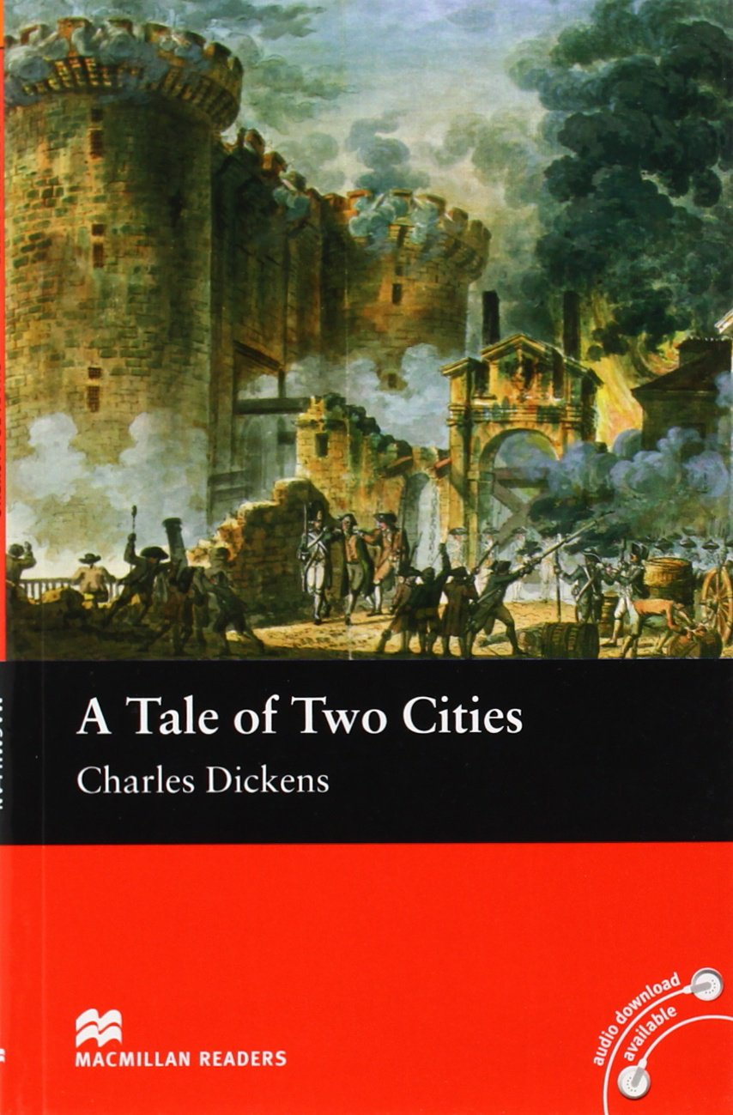
Agenda
Vocabulary - ლექსიკა
Main themes - მთავარი თემები
Conclusion and Homework - შეჯამება და დავალება
About the Author- ავტორის შესახებ
Summary - შინაარსი
Characters - გმირები
Setting - მოქმედების ადგილი და დრო

Slide 3
Vocabulary
shoemaker
(n.)
resurrected (adj.)
treason
(n.)
A person who makes shoes
Describes a person who was dead and came back to life
The crime of betraying one’s country
to sacrifice
(v.)
trial (n.)
To give up something of value for something or someone else
Examination of evidence to determine a person’s guilt
guillotine (n.)
execution
(n.)
prison (n.)
Machine designed to behead people during the French Revolution
Legally killing a person found guilty by the law
Place where accused criminals are held while waiting for their trial

Slide 4
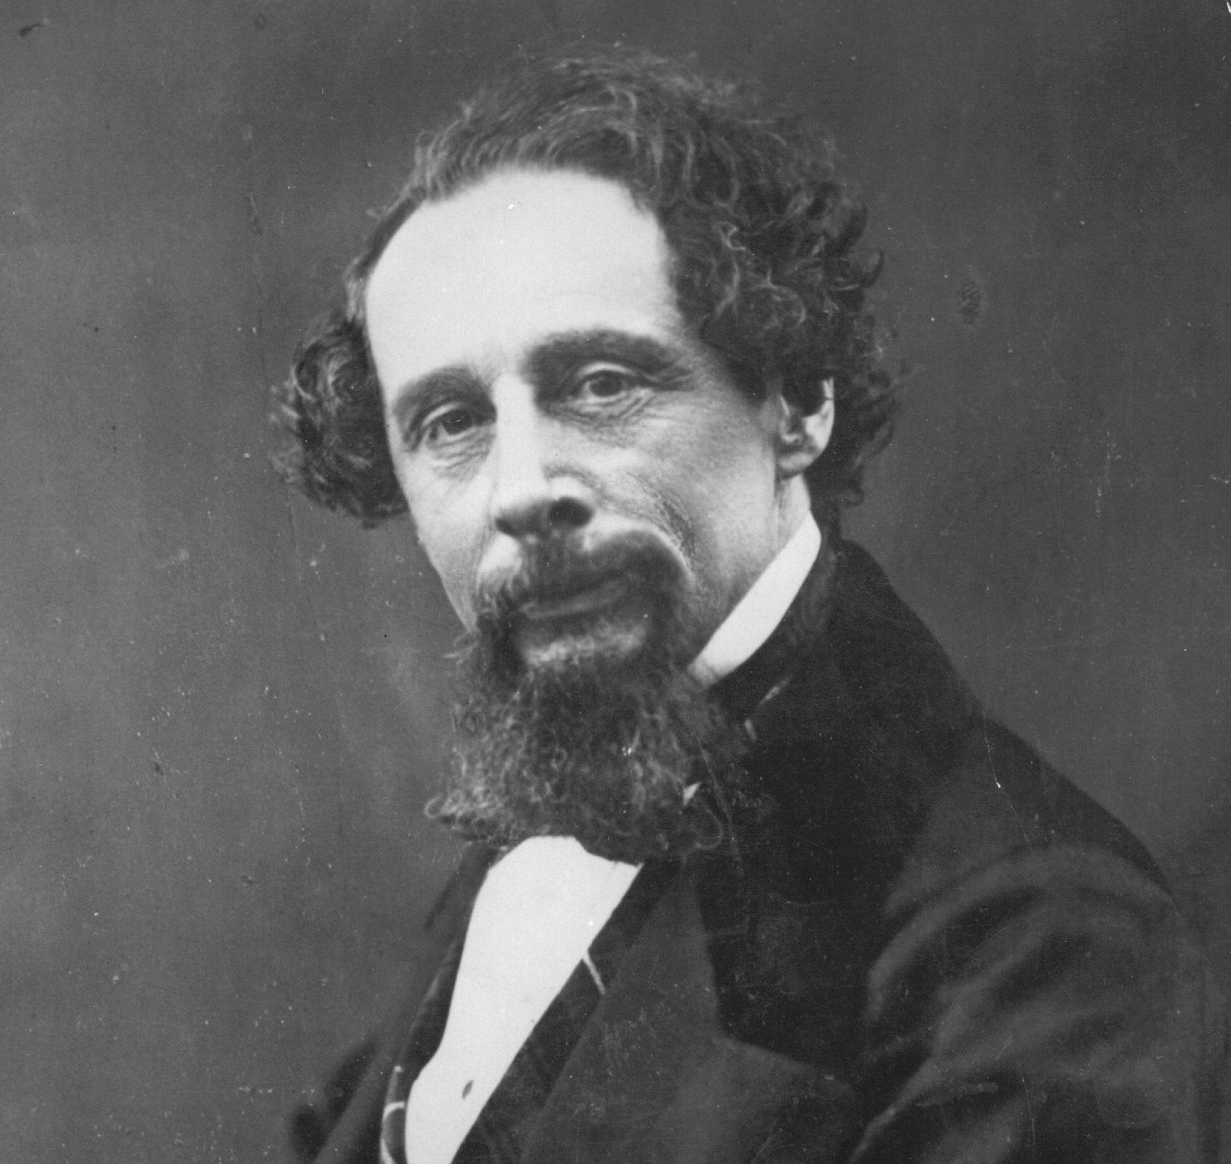
About the Author

Slide 5
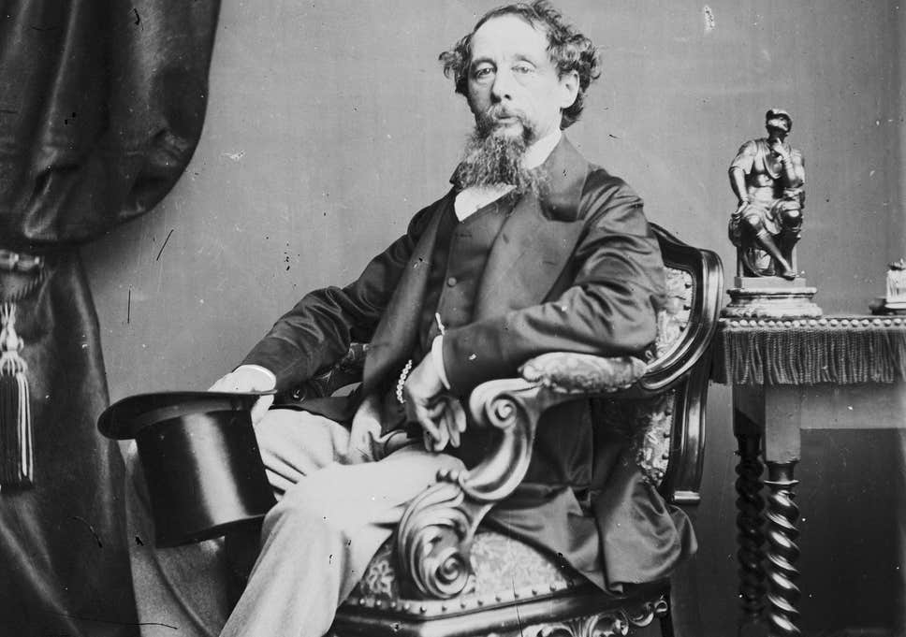
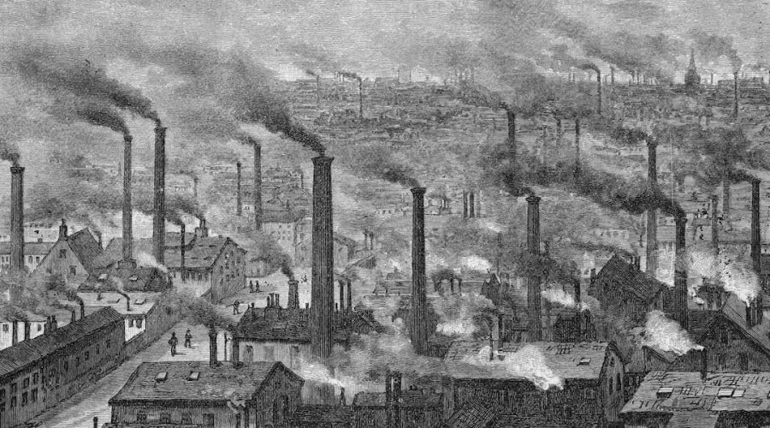
Charles Dickens
1812 – 1870
Portsmouth, England

Slide 6
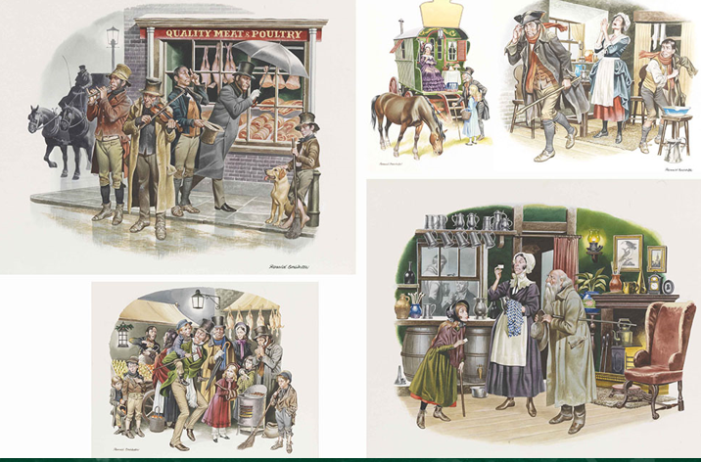
Summary შინაარსი

Slide 7
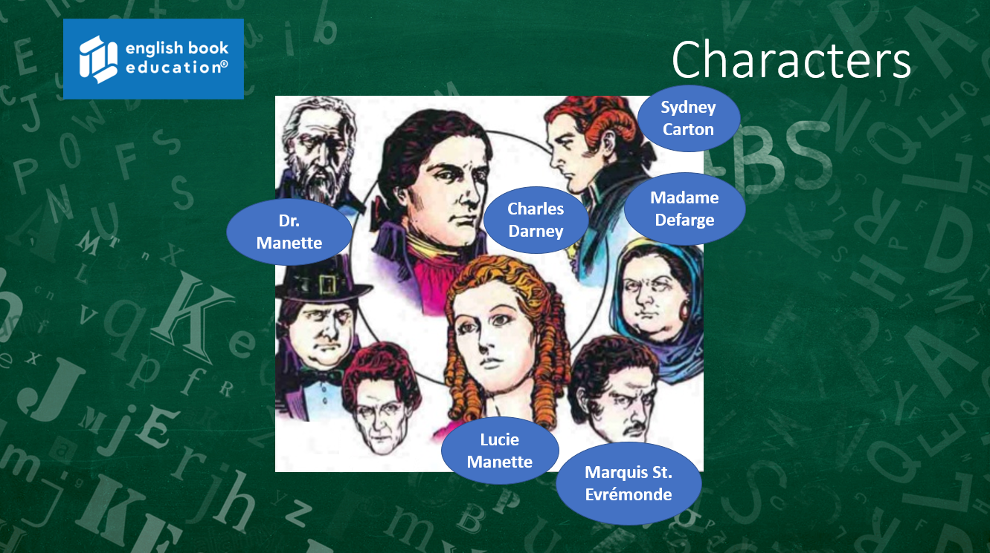

Characters

Slide 8
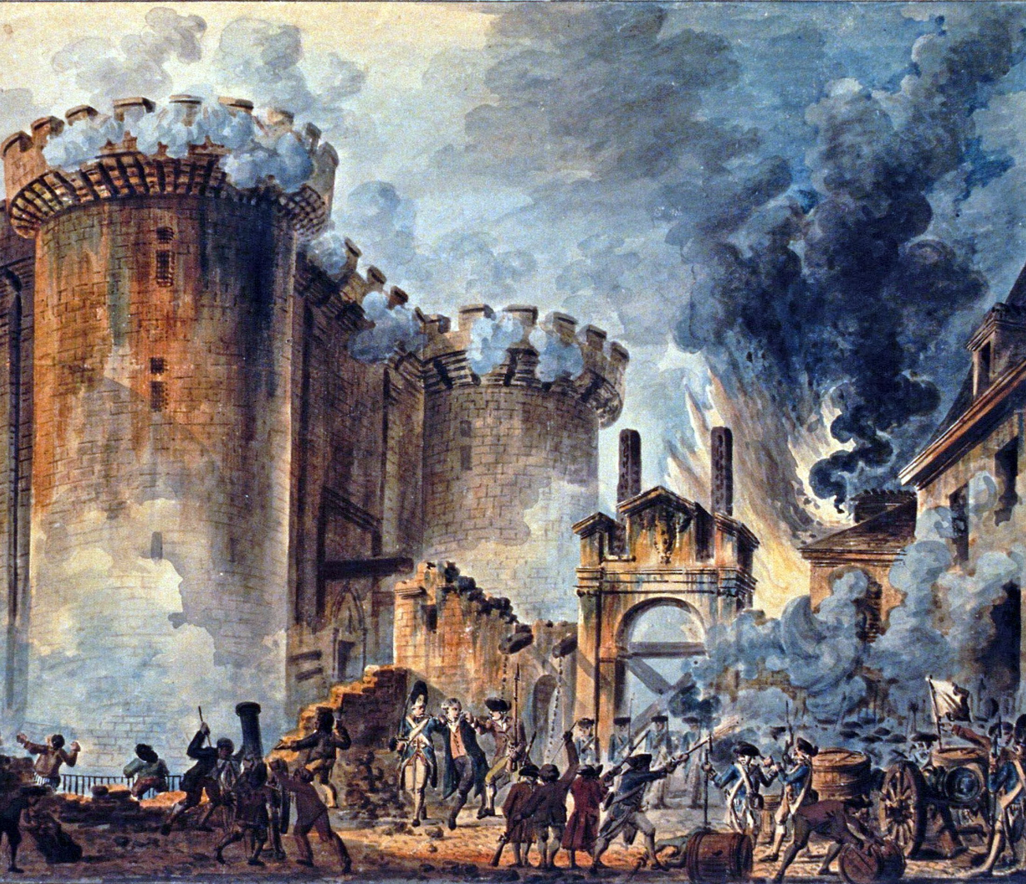
Setting მოქმედების ადგილი და დრო

Slide 9
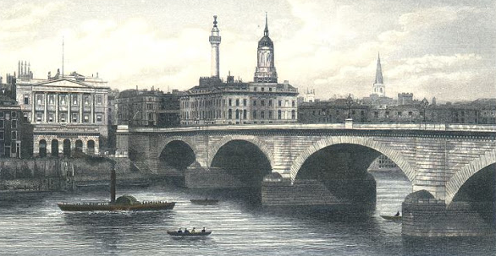
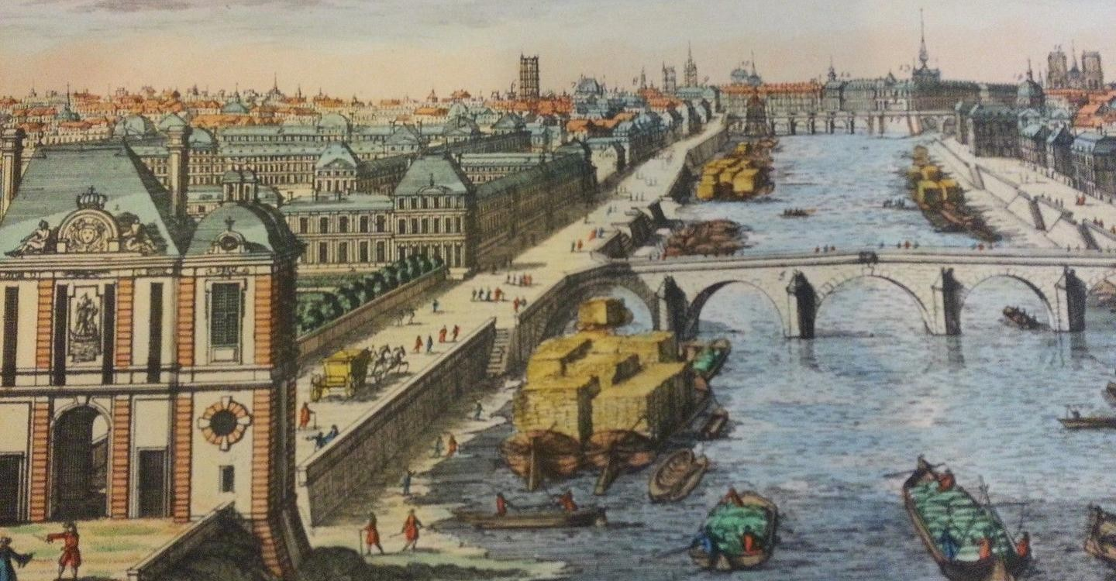
When
1775-1790
Where
London & Paris

Slide 10
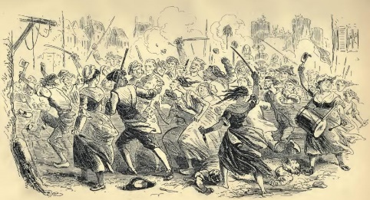
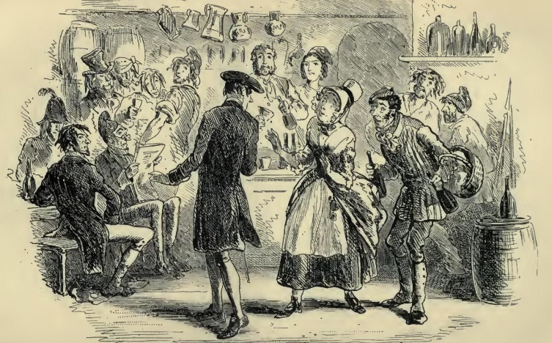
Main Themes მთავარი თემები

Slide 11
Conclusion
Author
Summary
Setting
Themes
Characters
Charles Dickens
Resurrection, Sacrifice, Violence, Duality
The story of the French Dr. Manette, his imprisonment in the Bastille in Paris and his release to live in London
1775-1790
London & Paris
Dr. Manette, Lucie Manette, Charles Darnay, Sydney Carton, etc.

Slide 12
Vocabulary
shoemaker
(n.)
resurrected (adj.)
treason
(n.)
A person who makes shoes
Describes a person who was dead and came back to life
The crime of betraying one’s country
to sacrifice
(v.)
trial (n.)
To give up something of value for something or someone else
Examination of evidence to determine a person’s guilt
guillotine (n.)
execution
(n.)
prison (n.)
Machine designed to behead people during the French Revolution
Legally killing a person found guilty by the law
Place where accused criminals are held while waiting for their trial

Slide 13
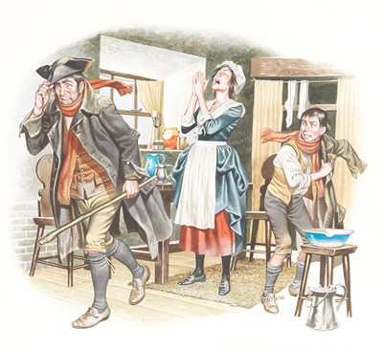
Homework
What do you think is the best way to make real change in society? Are there any areas you’d like to see change? In an ideal world, how would that change happen?
დავალება შეგიძლიათ
ატვირთოთ შემდეგ
მისამართზე:
www.englishbookeducation.co.uk/homework

